Slide 1

GPS and Closing Attainment Gaps
Henry Fernandez
Vice President | Complete College America
COMPLETE COLLEGE
AMERICA

Slide 2
GPS and Closing Attainment Gaps
Established in 2009, Complete College America is a national nonprofit with a single mission: to work with states to significantly increase the number of Americans with quality career certificates or college degrees and to close attainment gaps for traditionally underrepresented populations.

Slide 3
GPS and Closing Attainment Gaps

Slide 4
GPS and Closing Attainment Gaps

Slide 5
GPS and Closing Attainment Gaps

Slide 6
GPS AND CLOSING ATTAINMENT GAPS
Tim Renick
Vice Provost
Georgia State University
Allison Calhoun-Brown
Associate Professor/Director of Graduate Studies
Georgia State University
Carl McCray
Student
Georgia

Slide 7
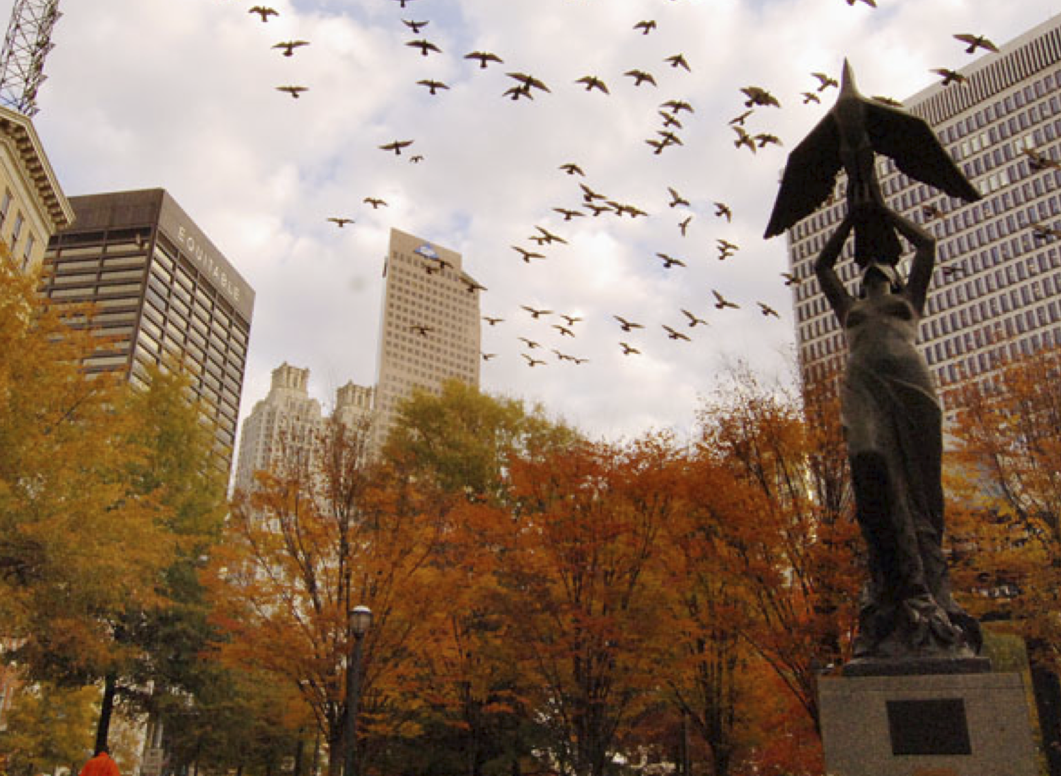
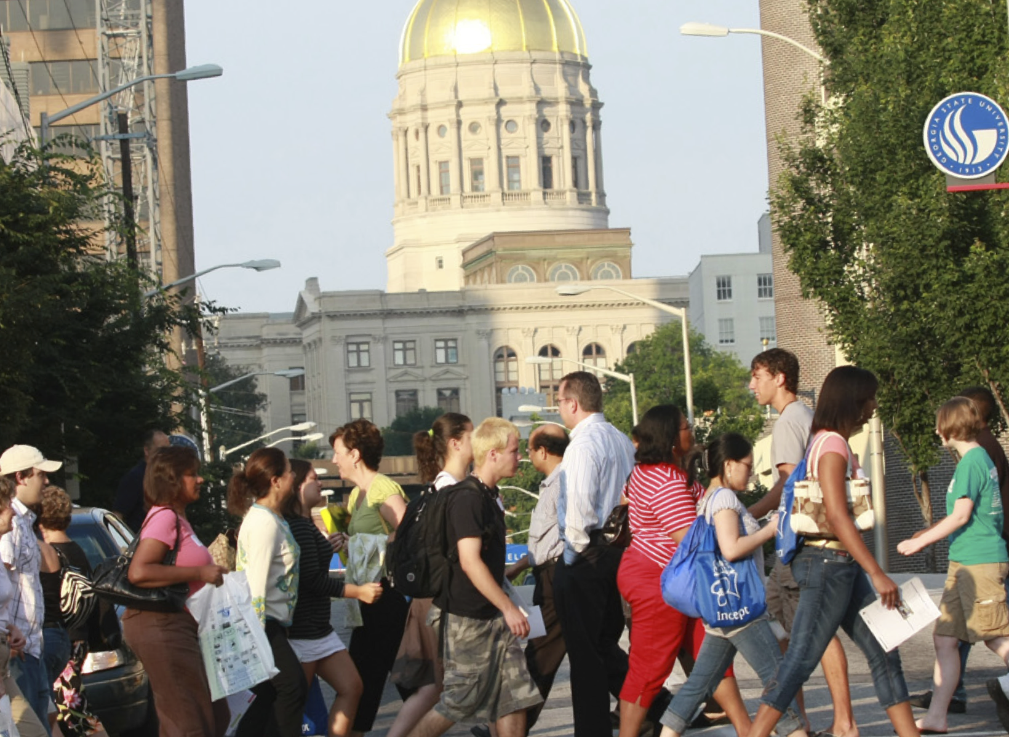
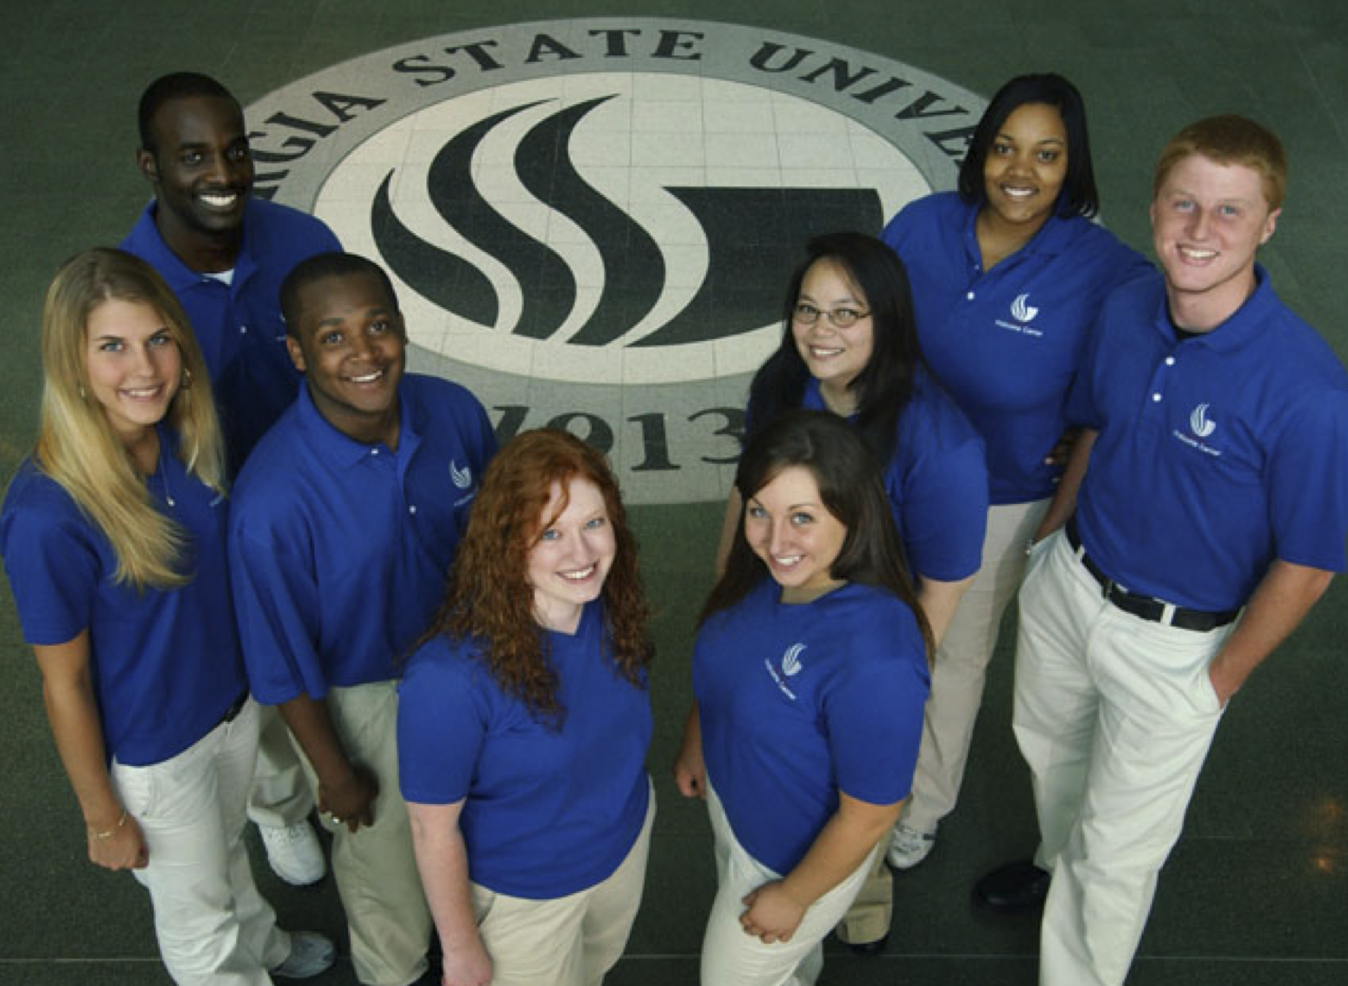
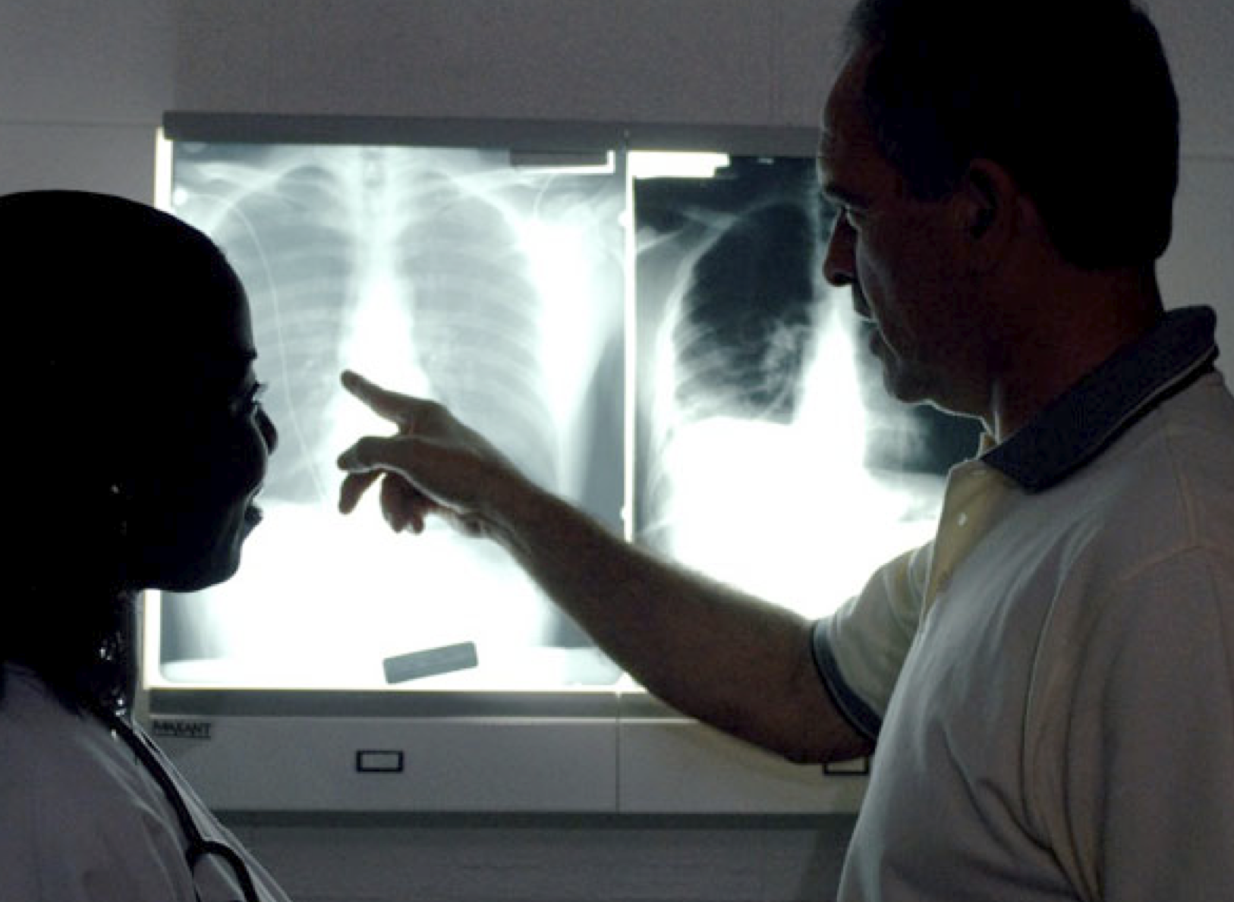

Complete College America Convening
October 13, 2015
Closing the Achievement Gap
Using GPS: Four Lessons
Timothy M. Renick, Ph.D
Allison Calhoun-Brown, Ph.D.
Carl McCray

Slide 8
Graduation Rates by Race & Ethnicity

Slide 9
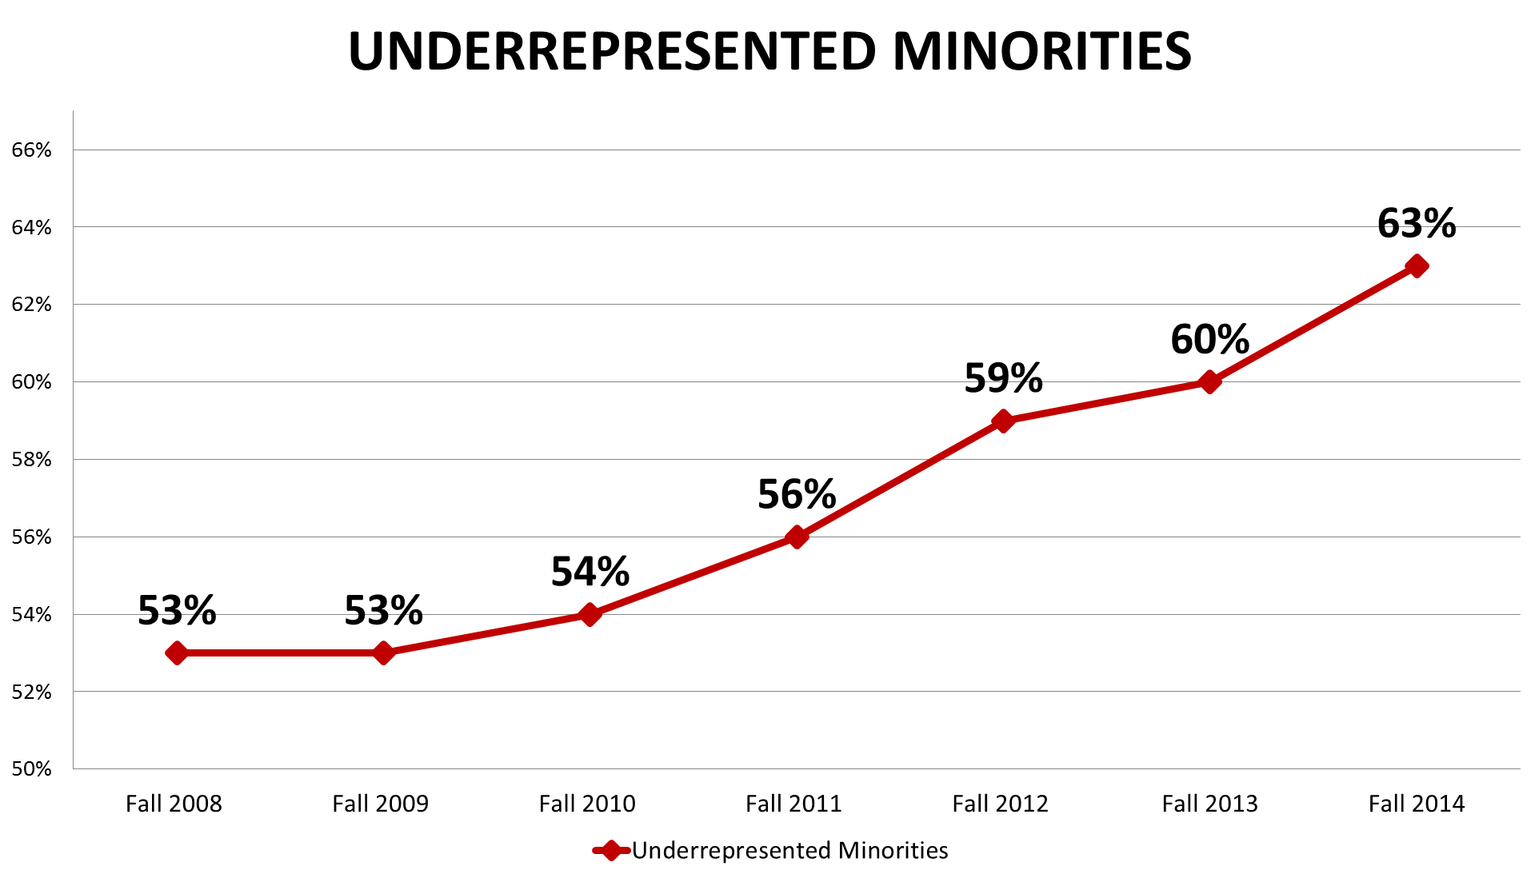
Changing Demographics: Race & Ethnicity
9

Slide 10
Changing Demographics: Pell
10

Slide 11

Georgia State Degree Conferrals
2008-09: 5,857 2014-15: 7,601 Increase: 1,744 (+30%)

Slide 12


 | 09-10 | 10-11 | 11-12 | 12-13 | 13-14 | 14-15 | 5-YR Change
AFRICAN AMERICAN | 1,001 | 1,322 | 1,440 | 1,550 | 1,692 | 1,825 | 82%
PELL | 1,298 | 1,648 | 1,835 | 2,007 | 2,052 | 2,501 | 93%
HISPANIC | 196 | 300 | 328 | 372 | 414 | 435 | 123%
Bachelor’s Degrees Awarded

Slide 13
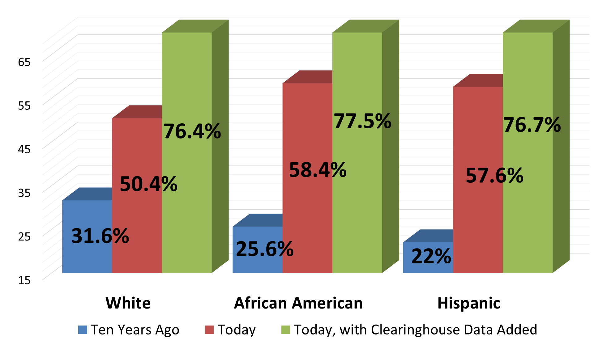
Graduation Rates by Race & Ethnicity

Slide 14
Lesson One
We’re the
Problem

Slide 15
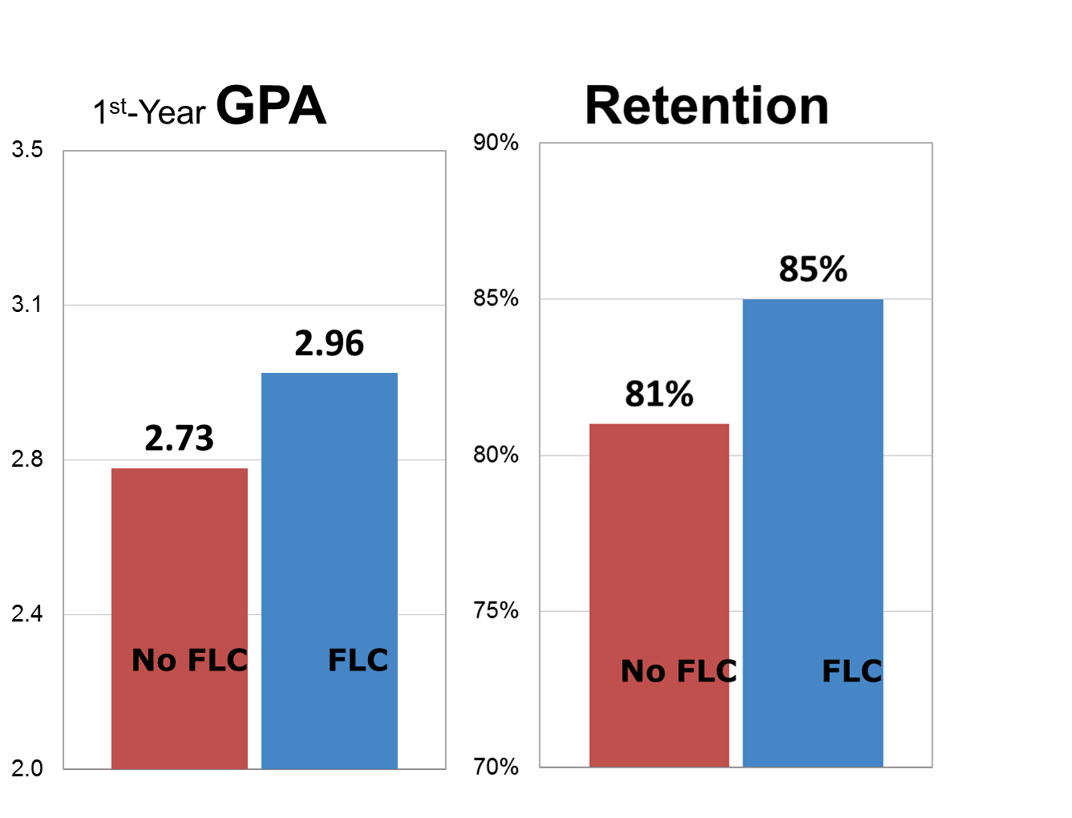
Freshman Learning Communities & Meta Majors
Freshman Learning Communities with Block Schedules of 5 to 6 courses: 95% of non-Honors Freshmen
(Opt-out model)
Meta Majors:
STEM
Business
Arts and Humanities
Health Education
Policy and Social Science
Exploratory
15

Slide 16
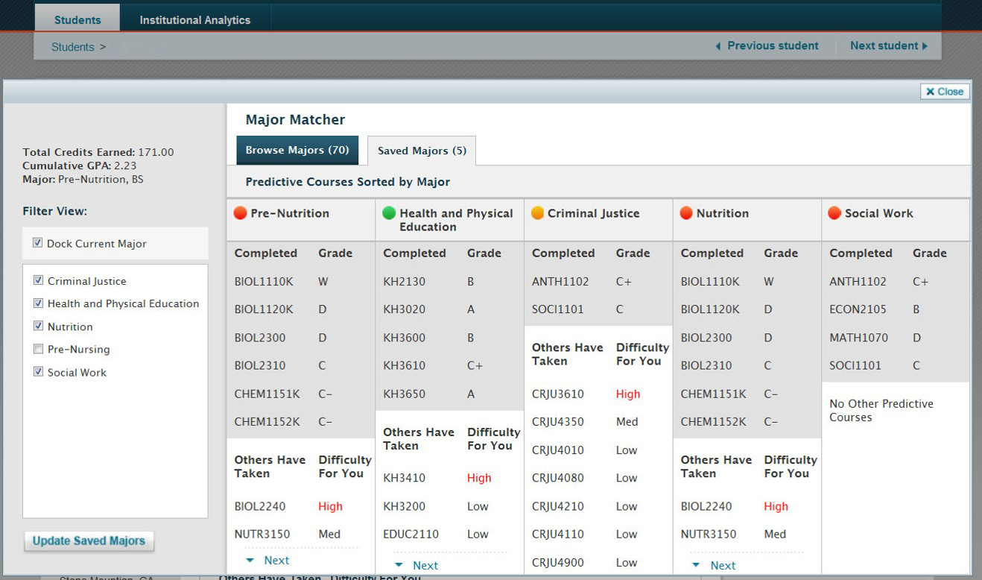
Major Matching
Predictive Analytics for Courses and Majors

Slide 17
Academic Program Maps

Slide 18
Lesson Two
It’s Technology

Slide 19
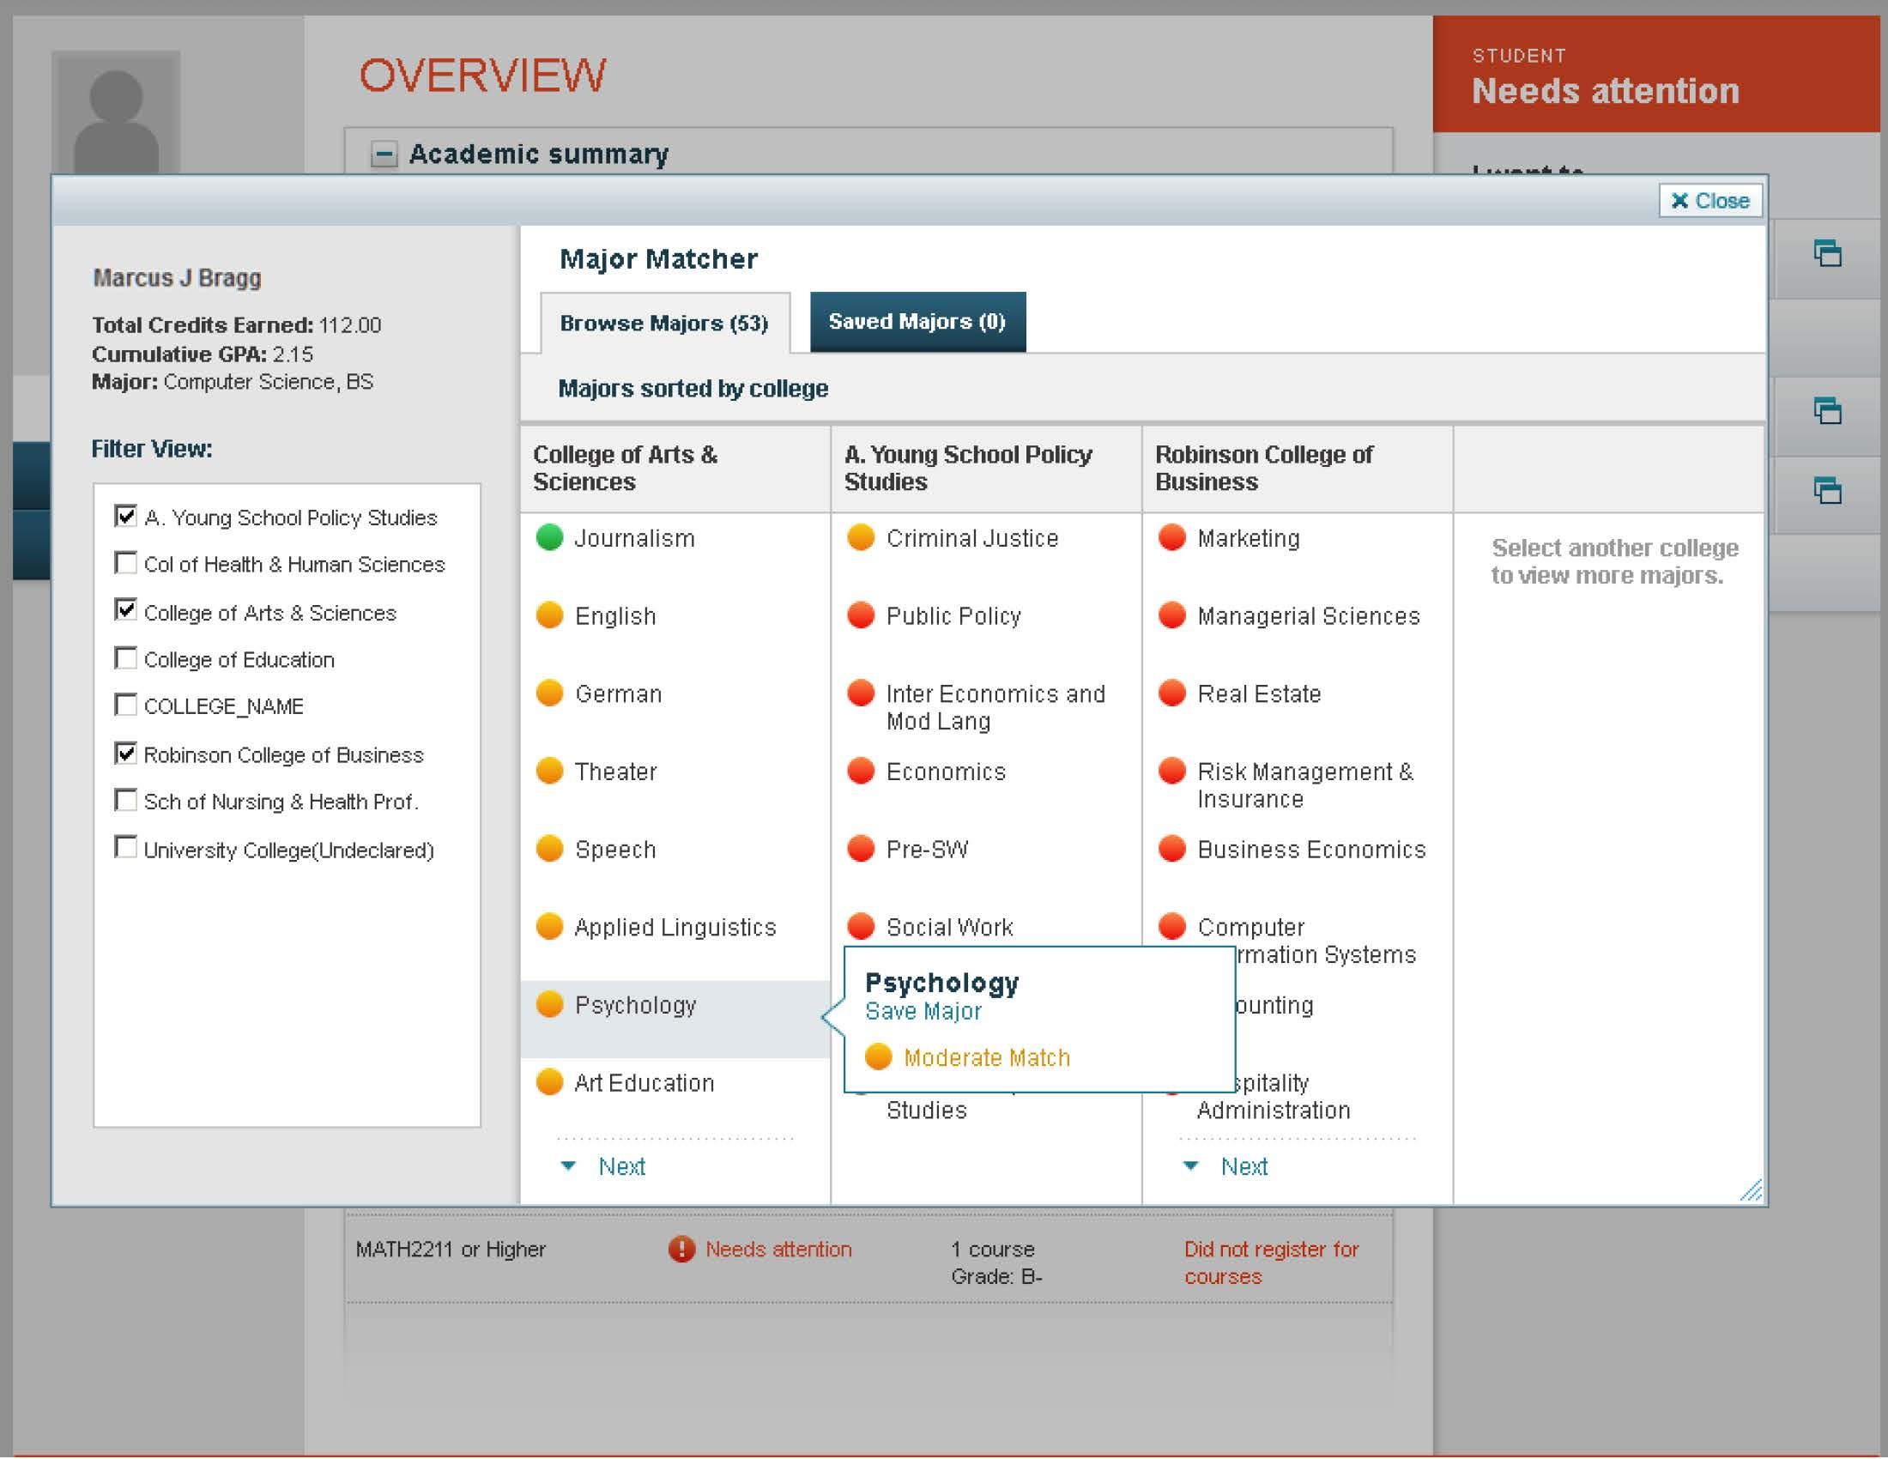
Advisement
Georgia State’s Web-Based GPS Advising System
A collaboration with the Education Advisory Board and four other schools
Based on 10 years of RPG data at Georgia State and 2.5 million grades
Live, nightly feeds from Banner and daily alerts to advisors if students have missed any of the markers
Predictive analytics for each student’s success in individual majors and courses
Tracks 700+ alerts for risk factors

Slide 20
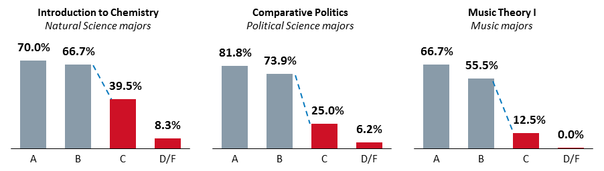
Alerts Based on Historical RPG Data
The Difference Between Satisfying a Requirement
and Being on Track
Graduation Rate in Major by Introductory Course Grade

Slide 21
Lesson Three
It’s Not
Only
Technology

Slide 22
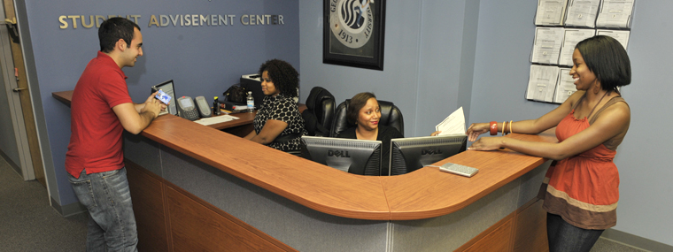
We Need to Change The Way We Operate
University Advisement Center student visits in the last 12 months: 43,422
Pre-Term Registration Corrections: 2,000+
Required Advising for Major Changes: 6,945

Slide 23
Lesson Four
We Can
Make A
Difference

Slide 24
