Slide 1

PURPOSE,
NOT PLACEMENT
Bruce Vandal
Senior Vice President | Complete College America
COMPLETE COLLEGE
AMERICA

Slide 2
Current Model Enrolls Most Students into Remediation
Remediation
Gateway
Percent of Students
70%
30%
Student Placement Data

Slide 3
Placement Exams Don’t Predict Success
50%
placed into remedial education could pass a gateway course

Slide 4
New Model Enrolls Most in College
Test Prep or Technical Certificate
Gateway Course with Corequisite Support
Gateway
Percent of Students
10%
60%
30%
Student Placement Data

Slide 5
A Model Pathway
Advise and Assess
Pre-Major Advising
Choose
Meta-major
Social Sciences
STEM
Humanities
Coreq
Coreq
Coreq
Gateway Math in 1st year
Stats
College Algebra
QR
Choose Major
Major
Major
Major

Slide 6
PURPOSE,
NOT PLACEMENT
Dhanfu Elston
Vice President | Complete College America
COMPLETE COLLEGE
AMERICA

Slide 7






GPS: Essential Components
DO THIS
Default Pathways
Purpose First: Informed Choice
Meta-Majors
Academic Maps
Critical Path Courses
Intrusive Advising

Slide 8
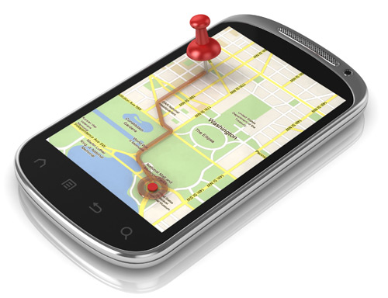

Slide 9
Poll: Are You in the Profession that You Anticipated When Entering College?
Yes or No
Notes:
Exploration is valuable, but DIRECTION is also – Meta Majors

Slide 10
Poll: How Many Years Since You Were An Undergrad in College?
Multiple Choice
Less than <5 years
5-10 years
10-20 years
20+ years
Notes:
Some things have changed and some have not over the years. Technology, curriculum, and emerging professions shape the decisions that students make

Slide 11



How are students choosing majors?

Slide 12




Slide 13
Poll: Would you like to do MATH every day of your life?
Multiple Choice
Yes!
I would if I had to
Absolutely NOT!
Notes:
Key questions related to interest, skills, and purpose MATTER

Slide 14
Questions for a Potential Nursing Student
Are you prepared for Chemistry 101?
Do you like working with people?
“Real-Life Questions”
How do you feel about working with BLOOD and BEDPANS?

Slide 15
A Critical Question
WHY ARE YOU HERE (pursuing a degree)?

Slide 16
PURPOSE, NOT PLACEMENT
Brian Bosworth
Founder and President
FutureWorks
Keith Witham
Assistant Professor of Higher Education | Temple University
Policy Advisor | Center for urban Education at University of Southern California
Drew Koch
Executive Vice President and Chief Academic Leadership and Innovation Officer
John N. Gardner Institute for Excellence in Undergraduate Education
Scott Evenbeck
President
Stella and Charles Guttman Community College

Slide 17
Purpose first
Creating Informed Choice
Helping Students Connect Academic & Career Goals

Slide 18
Audience Poll Placeholder slide
TEXT #### if you would choose a different major
TEXT #### if you would choose a different college
TEXT #### if you would choose BOTH a different college and a different major
Notes:
If you personally would make a different choice of institution or major given what you know now

Slide 19
Students choose where to enroll and what to study without good information
look at graduation rates
look at either employment rates or starting salaries of graduates
less than 50% of students
(McKinsey: Voice of the Graduate, 2013)
Notes:
If you said that you didn’t consider either graduation rates or labor market outcomes, you’re not alone. In fact, fewer than half of students in a 2013 McKinsey survey said they considered either when choosing a school and major. Really, we know that many make students based on convenience, location, and perceived affordability – without understanding the implications of their decision.

Slide 20
More than half of all graduates regret some of their choices in college
Different school
Different major
36%
17%
35%
53% regret at least one choice
(McKinsey: Voice of the Graduate, 2013)
Notes:
The result of poor information at the outset is regret later. Around a third of all graduates report they would choose a different school or major if they could do it again and around one in five would choose both differently. Considered together, more than half of all graduates surveyed would do something differently if they knew then what they know now.

Slide 21
PURPOSE MATTERS to student success. Why?
Deliberately selecting a program of study…
increases likelihood of completion
shortens time to completion
reduces unnecessary credits
Notes:
We know that helping students discern and develop a sense of purpose connected to their academic pursuits matters. What do we know?

Slide 22
PURPOSE MATTERS to student success. Why?
Connecting learning to a career goal…
increases engagement
increases persistence
helps students balance costs and benefits
Notes:
We also know that connecting learning in courses to a realistic career goal significantly increases engagement and commitment and helps students make better choices about, for example, using debt to finance their education and planning effectively for the amount of education they’ll need to get the careers they want.
AND that applied or work-based learning dramatically increases students’ sense of preparedness for work and satisfaction with their college education (McKinsey)

Slide 23

What many students experience NOW:
Placement exam
Academic advising
Before
At enrollment
During college
Last semester
Career interest/aptitude assessment (maybe)
Resume & job search help
Panic
…a disconnected set of tools and services
Notes:
But what is the typical experience of most college students? Disconnected both “vertically” – between academic and career planning – and “horizontally” across their experience as students.

Slide 24
What our research (and common sense) suggests would be better:
Before
At enrollment
During college
Last semester
Economic & non-economic ROI calculators available for all programs
Career advising integrated early & continuously into academic advising
Infusion of labor market info into learning mgmt platforms
Success
Career exploration built into curricula
Enhanced work-based learning opportunity
…a coherent system of tools and services
Notes:
We’ve asked experts and advisers and students over the course of a year and distilled what we learned into five strategies that we believe should be part of a coherent system of structured supports that would help students discern, develop, and work towards a realistic sense of purpose.
All colleges have some of these elements in place; but few have them meaningfully linked together so that students experience a seamless process of career and academic development. Institutions that are currently working towards building GPS structures and practices are particularly well positioned to leverage those structures to build a purpose-enhancing system.

Slide 25
Many stand-alone tools:
intoCareers
Youscience
iSeek
CareerCoach
Pymetrics
Viridis
Notes:
There are a lot of fairly good (and some not so good) stand-alone tools out there to help students explore careers and majors – most of your colleges and universities are already investing in some of these and your career counseling and advising professionals know these and dozens more.

Slide 26
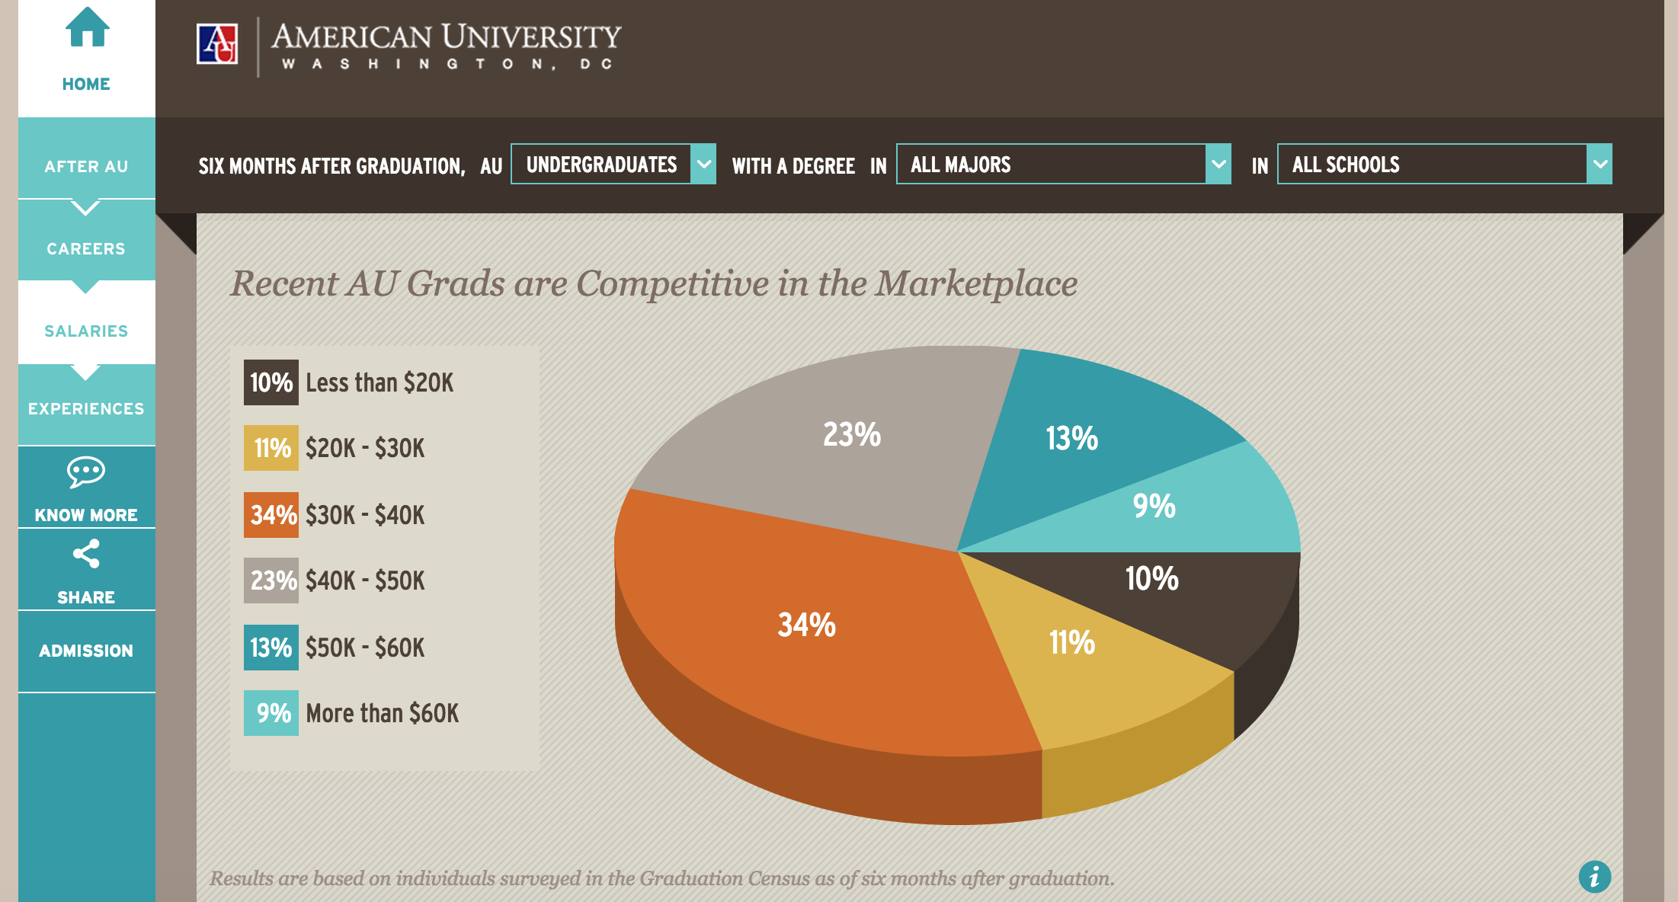
American University “We Know Success”
Notes:
And some institutions are starting to make very good use of labor market outcome data to help students understand ROI for programs of study.

Slide 27
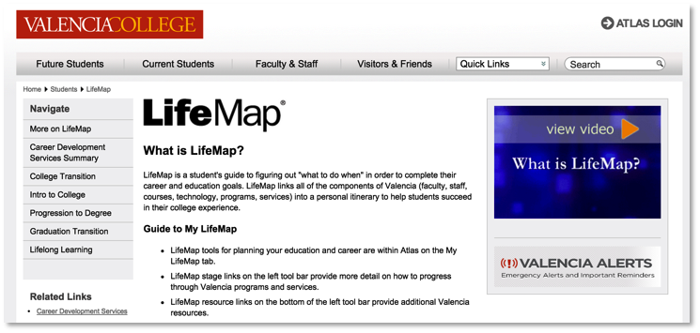
Valencia College Atlas & LifeMap
Notes:
But we find very few examples of all of these functions being integrated into a single system that stretches across students’ experience and integrates academic and career planning.

Slide 28
Purpose first. How and why?
Drew Koch, PhD
Executive Vice President & Chief Academic Leadership & Innovation Officer
John N. Gardner Institute for Excellence in Undergraduate Education
Scott Evenbeck, PhD
President, Guttman Community College (CUNY)
Notes:
Here to talk to us about how and why existing student success efforts should be leveraged to develop these “purpose first” strategies are Drew Koch and Scott Evenbeck. (Introductions)

