Slide 1

FIFTEEN TO
FINISH
Enrollments and Common Cents
Dhanfu Elston
Vice President | Complete College America
COMPLETE COLLEGE
AMERICA

Slide 2


Slide 3

Fifteen to Finish
DC
Statewide Initiatives
States with Campus-Based Initiatives

Slide 4
15 or More Credit Hours Attempted and Completed - Fall Semester
Indiana University Purdue University - Indianapolis

Slide 5

% First-Time, Full-Time Students Enrolled
in 15+ Credit Hours (1st Semester)

Slide 6
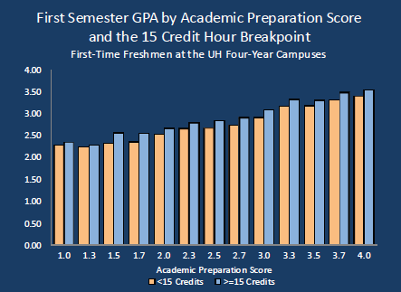
At every level of academic preparation, students taking 15 hours had higher GPAs

Slide 7
Projected Enrollment Revenue Opportunity
Revenue Gains vs. Baseline
Model Inputs:
Total Enrollment: | 8,639
Net Revenue Per Student: | $10,565
(net tuition and fees plus state appropriations)
19
Retention Improvement
0-29 credits | 4.7% total over 1 year
30-59 credits | 0% total over 1 year
60-89 credits | 0% total over 1 year
90-119 credits | 0% total over 1 year
120+ credits | 0% total over 1 year
additional graduates in 2019 as result of retention improvement

Slide 8
It’s not just taking fifteen (15)…
It’s about taking
the RIGHT fifteen!

