Slide 1

COREQUISITE
REMEDIATION
Spanning the Divide
Bruce Vandal
Senior Vice President | Complete College America
COMPLETE COLLEGE
AMERICA

Slide 2


Slide 3

Remediation
Too many students start college in remediation.
^{61% in 2-year}
^{28% in 4-year non- flagship}

Slide 4
African Americans, Hispanics and Pell Students are Over Represented
2-year Students
4-year Non-Flagship Students

Slide 5
Most are in Math – Far Too Many Require Both Math and English
2-year Students

Slide 6
Access to College or Remediation
For too many students, a remedial class is their first and their last college experience.

Slide 7
The System Does Not Work, Particularly for African Americans
Gateway Course Completion in 2 years
2-year college remedial students

Slide 8
Remediation
Student attrition is at the heart of the matter.

Slide 9
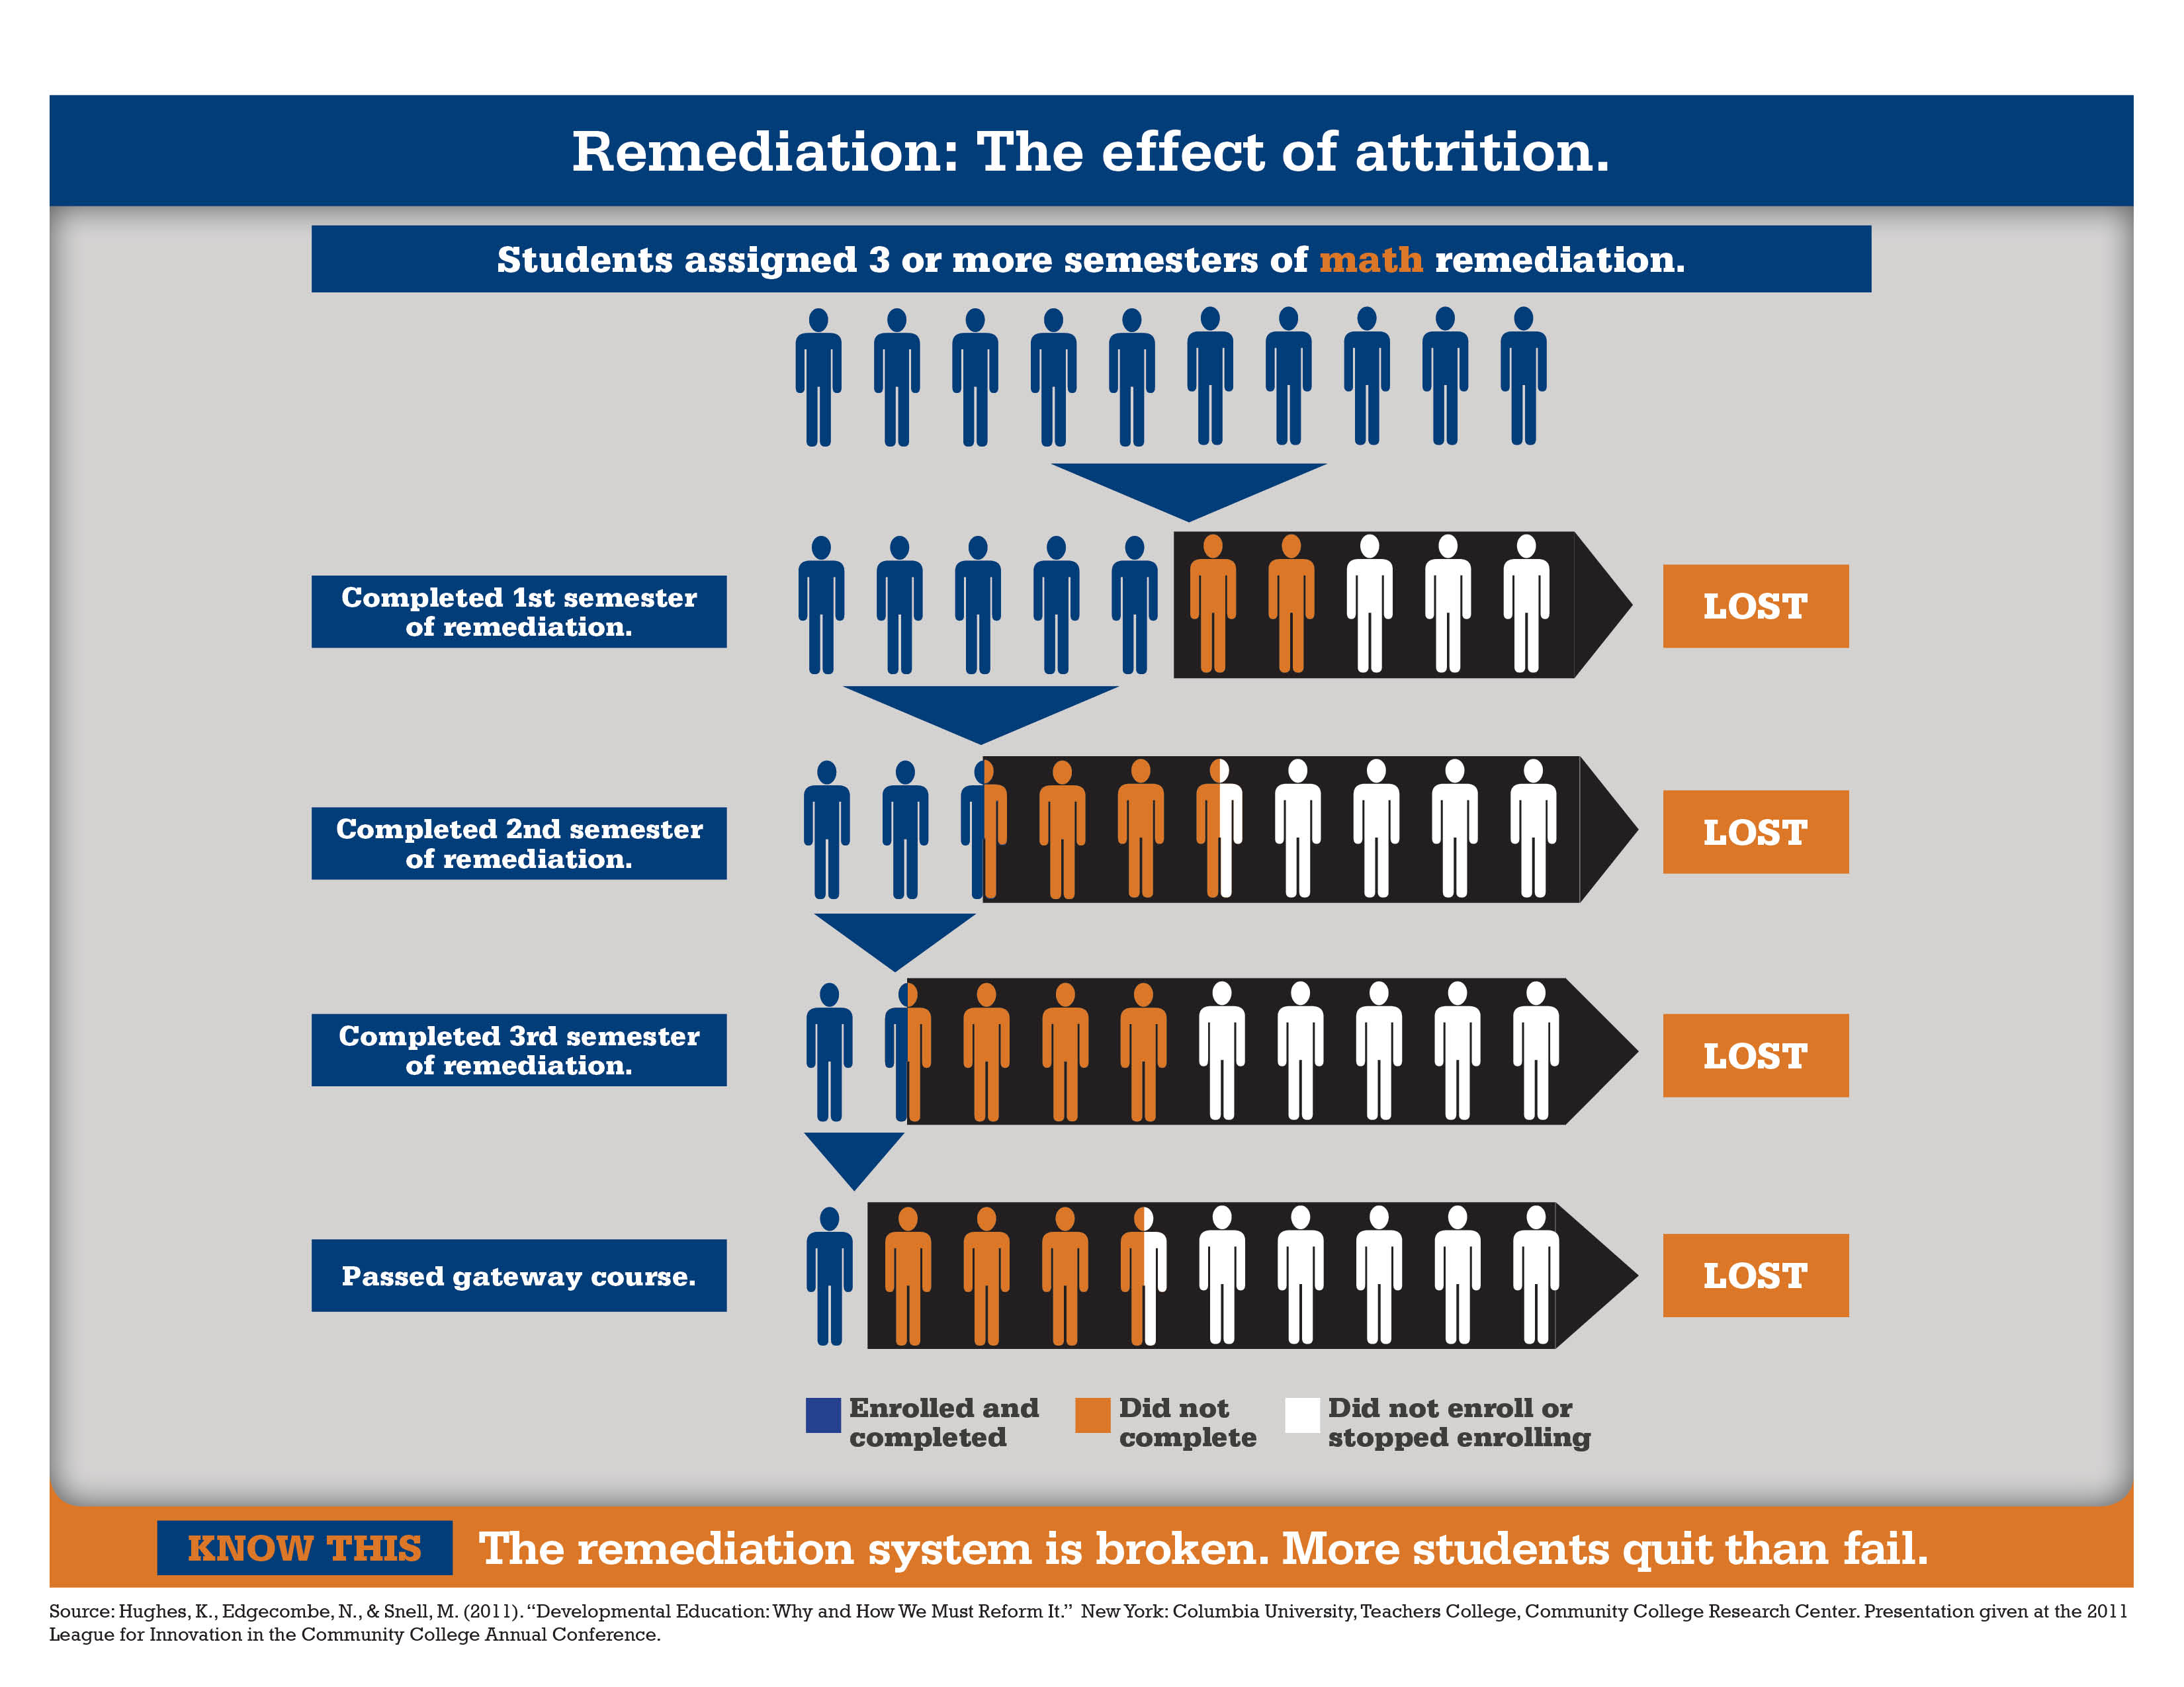

Slide 10
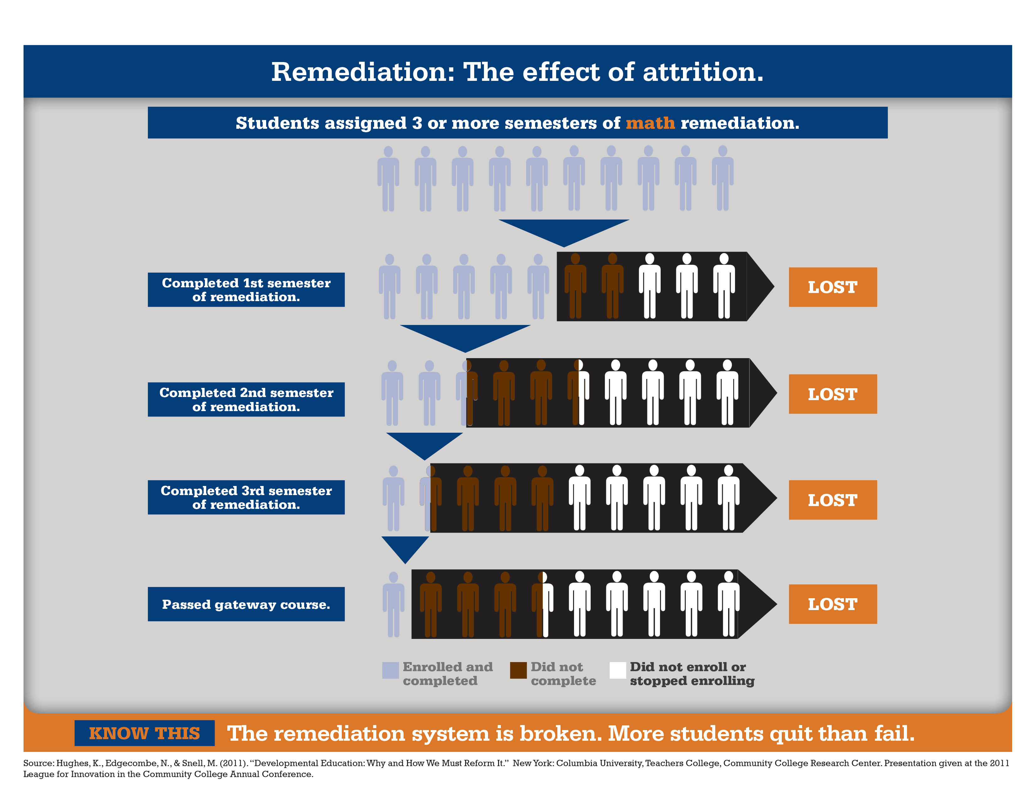

Slide 11
Corequisite Remediation
Provide academic support as a Corequisite not as a
prerequisite

Slide 12
The Corequisite Strategy
More time on task and help for students when they need it (just in time).

Slide 13
One Semester Corequisite Results
Institution | Subject | Traditional Model | Corequisite Model
CC of Baltimore County | English | 33% | 74%
Austin Peay State University | English | 49% | 70%
 | Quantitative Reasoning | 11% | 78%
 | Statistics | 8% | 65%

Slide 14
The Movement to Corequisite at Scale
Five States Have Achieved Scale
Colorado, Georgia, Indiana, Tennessee and West Virginia
Moving to Scale
Texas, Nevada, Kentucky
13 Alliance Members Committed to Scale by 2018
Hawaii, Oklahoma, Ohio, New Mexico, Idaho, Missouri, Montana, DC, Illinois, CVHEC, Massachusetts, Rhode Island, Maryland

