Slide 1

Corequisite Remediation At Scale
Bruce Vandal | Vice President, Complete College America
Deborah Lott | Student, Ivy Tech Community College of Indiana
Mary Ostrye | Senior Vice President and Provost, Ivy Tech Community College of Indiana
James Skidmore | Chancellor, West Virginia Council for Community and Technical College Education

Slide 2

Corequisite Remediation

Slide 3

Remediation
Too many students start college in remediation.
^{60%}

Slide 4
Remediation
Too few remedial students ever graduate.
^{1 in 10}

Slide 5
Remediation
Student attrition is at the heart of the matter.

Slide 6
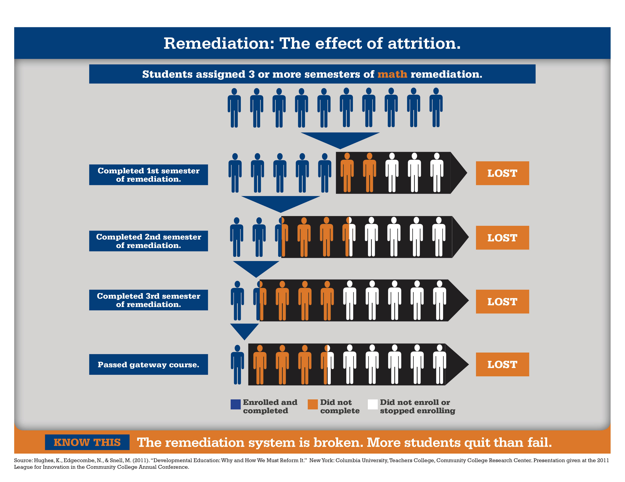

Slide 7
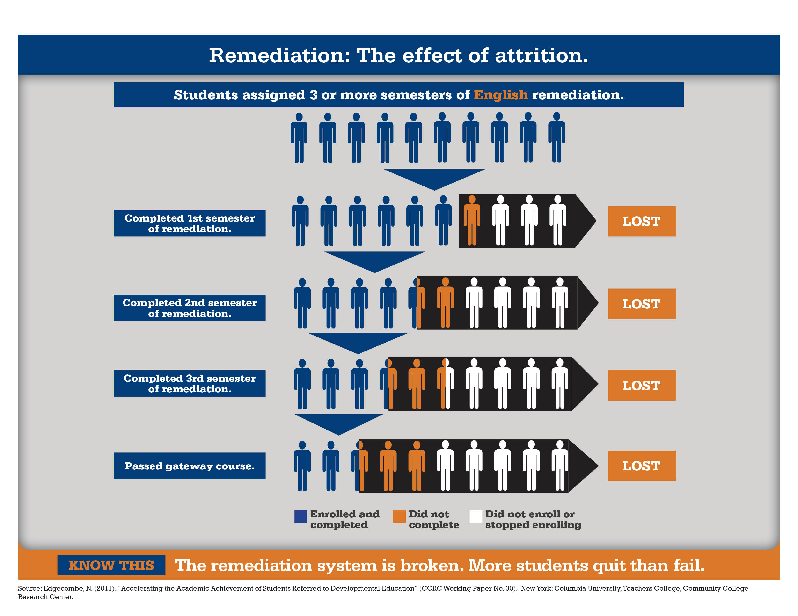

Slide 8
Corequisite Remediation
Provide academic support as a corequisite not as a
prerequisite

Slide 9
Corequisite Remediation
More time on task and help for students when they need it (just in time).

Slide 10
Corequisite Options
45 minutes after class
An additional class period or two
Required lab with mentors
5 weeks dev ed, 10 weeks regular course (5 days/wk)
Two semester stretch course

Slide 11
One Semester Coreq Results
Community College of Baltimore County (Accelerated Learning Program)
74%
33%
Traditional Model
Coreq
ENGLISH

Slide 12
One Semester Coreq Results
Austin Peay State University (Structured Assistance)
65%
70%
78%
49%
11%
8%
Traditional Model
Coreq
Traditional Model
Coreq
Traditional Model
Coreq
ENGLISH
QUANTITATIVE REASONING
STATISTICS

Slide 13
Current Model Enrolls Most in Remediation
Remediation
Gateway
Percent of Students
70%
30%
Student Placement Data

Slide 14
New Model Enrolls Most in College
Test Prep or Technical Certificate
Gateway Course with Corequisite Support
Gateway
Percent of Students
10%
60%
30%
Student Placement Data

Slide 16
Ivy Tech Community College
Moving to Scale: Writing
Spring, 2014
Fall, 2014
Fall, 2016

Slide 17
Ivy Tech Community College
Moving to Scale: Math
Spring, 2015
Fully scaled Quantitative Reasoning Course with Corequisites
Fully scaled Technical Math Pathway
Strategy covers over 60% of students
Math Pathways on the horizon

Slide 18
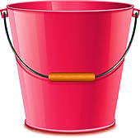
For every 100 students attempting Reading remediation…
100
65
47
37
Attempted remedial reading
Completed remedial reading
Attempted gateway English
Completed gateway English
Leave Pipeline:
35
18
10
27% of those who require reading remediation never attempt it.
2009 ATD cohort – by end of spring 2012 semester (6,702 tested into reading remediation)
Time lapse: 1 to 3 years

Slide 19

In co-req model, for every 100 students attempting Reading remediation…
100
49
Attempted remedial & gateway English
Completed gateway English
Leave Pipeline:
51
Spring 2014 (all students – 423 students
Time lapse: 4 months

Slide 20
For every 100 students attempting Writing remediation…
100
62
48
37
Attempted remedial writing
Completed remedial writing
Attempted gateway English
Completed gateway English
Leave Pipeline:
38
14
11
27% of those who require writing remediation never attempt it.
2009 ATD cohort – by end of spring 2012 semester (8,255 tested into writing remediation)
Time lapse: 1 to 3 years

Slide 21
In co-req model, for every 100 students attempting Writing remediation…
100
52
Attempted remedial & gateway English
Completed gateway English
Leave Pipeline:
48
Spring 2014 (all students – 1054 students
Time lapse: 4 months

Slide 22
For every 100 students attempting Math remediation…
100
49
36
29
Attempted remedial math
Completed remedial math
Attempted gateway math
Completed gateway math
Leave Pipeline:
51
13
7
18% of those who require math remediation never attempt it.
2009 ATD cohort – by end of spring 2012 semester (17,785 tested in math remediation)
Time lapse: 1 to 3 years

Slide 23
In co-req model, for every 100 students attempting Math remediation…
100
52
Attempted remedial & gateway math
Completed gateway math
Leave Pipeline:
48
Spring 2014 (all students – 2103 students
Time lapse: 4 months

Slide 25
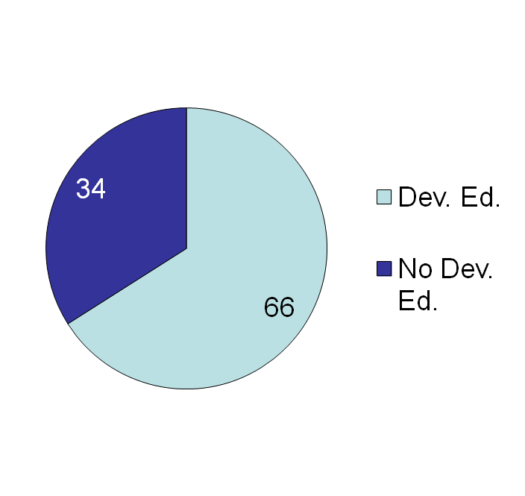
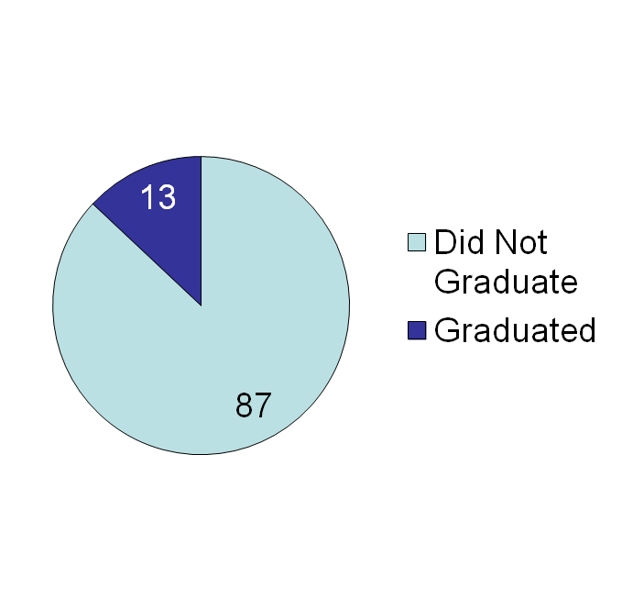
The Problem
First-Time Freshmen In Developmental Education
Graduation Rate of Developmental Education Students

Slide 26
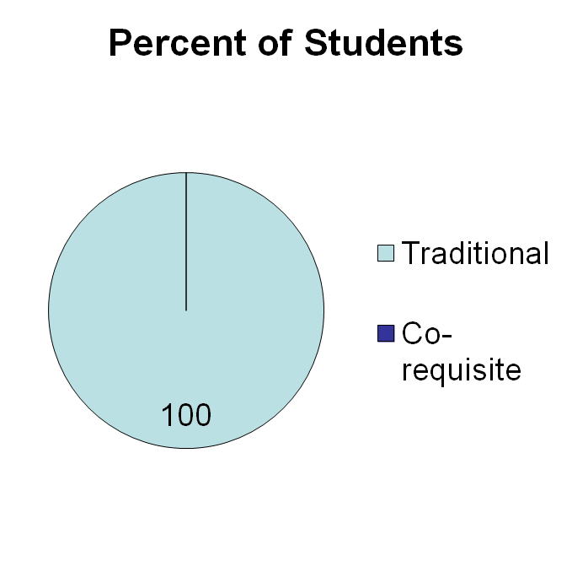
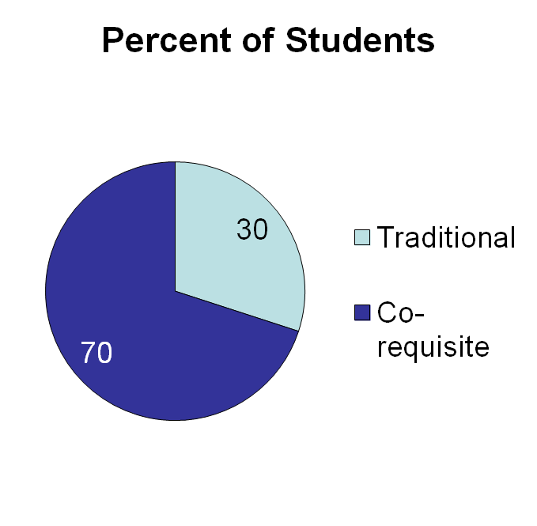
Developmental Education Courses
2011- Math
2014- Math

Slide 27

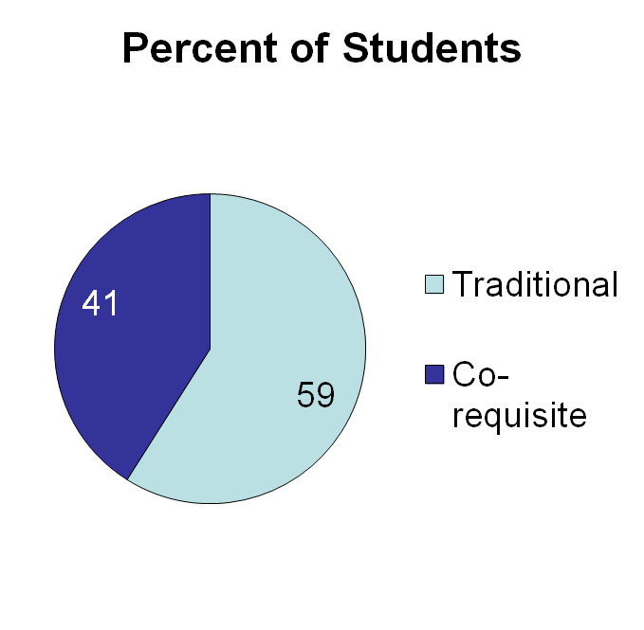
Developmental Education Courses
2011- English
2014- English

