Slide 1

Leveraging the Power of Data to Inspire and Reward Reform
Jason Bearce | Associate Commissioner for Communications, Indiana Commission for Higher Education
John Morgan | Chancellor, Tennessee Board of Regents
Brett Visger | Associate Vice Chancellor, Ohio Board of Regents
Katie Zaback | Senior Policy Analyst, State Higher Education Executive Officers Association

Slide 2


Slide 3

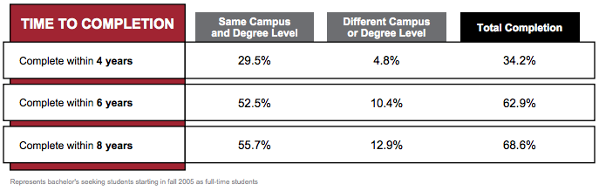

Slide 4
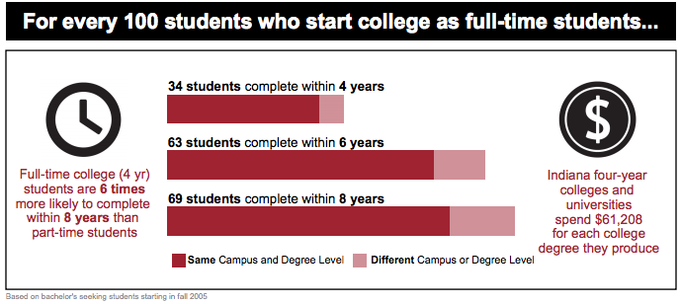

Slide 5
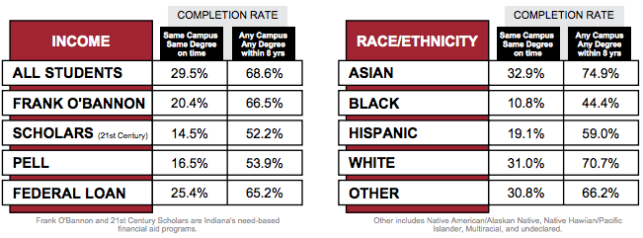

Slide 6
