Slide 1

Uncovering the Momentum of 15 to Finish
Blake Johnson | Director of Communications, Complete College America
Dhanfu El-Hajj Elston | Executive Director of Student Success and Transition, Purdue University Calumet
Wayne Hill | Chief Marketing Office, The University of Akron
Kathy Johnson | Associate Vice Chancellor for Undergraduate Education, IUPUI
Serene Klempin | Research Associate, Community College Research Center

Slide 2

Fifteen to Finish
DC
Statewide Initiatives
States with Campus-Based Initiatives

Slide 3
The Power of 15 Credits: More students graduate when they complete 30+ credits in their first year.

Slide 4
The Power of 15 Credits: More students graduate when they complete 30+ credits in their first year.

Slide 5
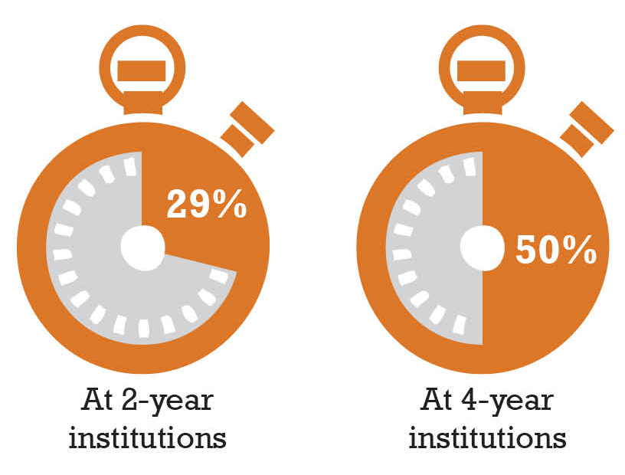
Most students DON’T take the credit hours necessary to graduate on time.
Full-time Students Taking
15+ Credits Per Semester

Slide 6
Hawai’i’s 15 to Finish
Significant results in campaign’s very first year.

Slide 7
Wayne Hill, Associate Vice President and Chief Marketing Officer
The University of Akron

Slide 8
CAMPAIGN GOALS
Change campus language/culture to “Full Time” = 15/16 credit hours per semester
    30 to 32 hours per year (including summer)
Increase % of incoming freshmen taking 15/16 credit hours per semester
Increase % of continuing students taking 15/16 credit hours per semester

Slide 9
ANALYSIS 2010-12 COHORTS
ACT & credits attempted-first fall semester | Retention rate (%) | Mean first-year GPA | Mean first-year credits earned
ACT < 20 & Credits (<15) | 53.00% | 2.08 | 19.2
ACT < 20 & Credits (15+) | 65.50% | 2.44 | 24.7
ACT 20-23 & Credits (<15) | 61.70% | 2.37 | 23.8
ACT 20-23 & Credits (15+) | 72.50% | 2.7 | 27.4
HIGHLIGHTS
Retention rates ranged from 10% higher to 23% higher for students taking 15+ credits
First-year GPA was 0.28 to 0.36 higher, on average, for students taking 15+ credits
Students taking 15+ credits earned, on average, 2 to 6 more credits toward degree
Students taking 15+ credits were similar in age to students taking <15 credits

Slide 10
ANALYSIS 2010-12 COHORTS
ACT & credits attempted-first fall semester | Retention rate (%) | Mean first-year GPA | Mean first-year credits earned
ACT 23-27 & Credits (<15) | 70.10% | 2.67 | 29.2
ACT 23-27 & Credits (15+) | 79.90% | 2.95 | 31.2
ACT ≥ 27 & Credits (<15) | 80.60% | 3.01 | 34.6
ACT ≥ 27 & Credits (15+) | 88.70% | 3.32 | 40.6
HIGHLIGHTS
Retention rates ranged from 10% higher to 23% higher for students taking 15+ credits
First year GPA was 0.28 to 0.36 higher, on average, for students taking 15+ credits
Students taking 15+ credits earned, on average, 2 to 6 more credits toward degree
Students taking 15+ credits were similar in age to students taking <15 credits

Slide 11

TACTICS
Deans presentation
Advisors discussion
Messaging and graphic identity (right)
Video (right)
Web page (right)
www.uakron.edu/finish

Slide 12

TACTICS
New Student Orientation presentations
Poster (right)
E-mail timed to registration
TV information screens on campus/residence halls
Campus and student e-mail announcements

Slide 13

TACTICS
Social media (right)
Table tents
Parent newsletter
COST: ABOUT $1,500

Slide 14
RESULTS
Percent of NEW full-time freshmen registered for 15+ credits

Slide 15
Your questions
Wayne Hill, Associate Vice President and Chief Marketing Officer
whill@uakron.edu | 330-972-2148 | The University of Akron

Slide 16



at
Data-Driven Strategy:
Institutional Research Report produced in April, 2013 and shared with Council on Retention and Graduation
IR director shared briefer version with all academic advisors engaged in Summer 2013 & 14 Orientation

Slide 17
15 or More Credit Hours Attempted and Completed - Fall Semester

Slide 18
15 or More Credit Hours Attempted Spring 2014

Slide 19
Many Students Attempting (but not completing) 15 Still Earned Credit

Slide 20

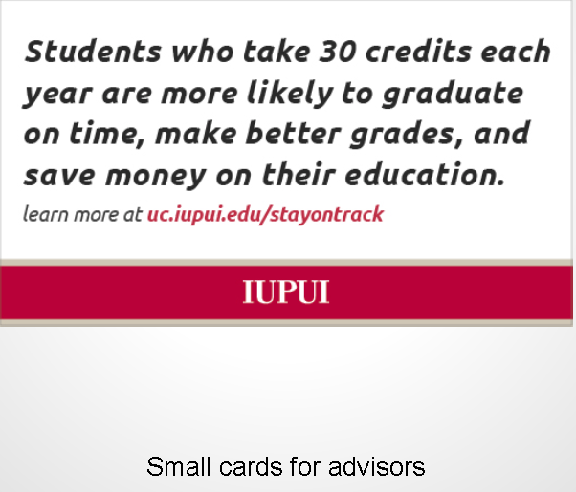

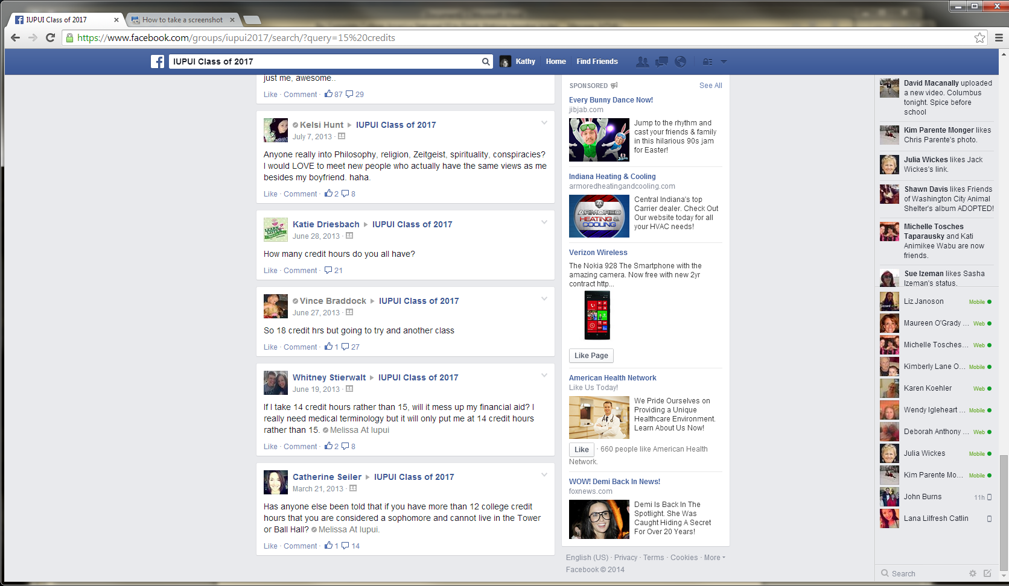

Communications to Students
Banners, posters and digital signs:

Slide 21

Building a Culture of Timely Graduation
Background
PUC has long served a population of underserved students: first-generation, commuter, low socio-economic status, and racial minorities
Steady transition from part-time non-traditional to traditional full-time students
Fall 2013 began focus on timely graduation
Institution by the Numbers
Located in Hammond, IN
Public Master’s University
8,600 undergraduate enrollment
31% overall graduation rate
74% first-year retention rate

Slide 22


Purdue University Calumet
Full-Time is 15
Comprehensive Institutional Plan
  New Student Orientation
    Clear, Introductory Messages to Students & Parents
  Degree Maps (4-year)
  Block Scheduling
    (Opt-Out vs. Opt-In to 15 credit hours)
  Reinforced Messages
    Academic Advisors
    Marketing Campaign

Slide 23
% First-Time, Full-Time Students Enrolled in
15+ Credit Hours (1st semester)

Slide 24
15-Credit Strategies
Type of Strategy | Definition
Financial incentives | Completion of 15 credits per semester required for financial aid or scholarships
Public awareness campaigns | Advertising importance of 15 credits for on-time completion through “15 to Finish” campaigns marketed to the general public through TV, other media
Institutional awareness campaigns | Within-campus efforts to promote importance of 15 credits for on-time completion
Structural reforms | State or institutional policies making 15 credits the normal full-time course load

Slide 25
15-Credit Policies
Type of Policy | Definition
Banded tuition | Fixed tuition rate for a specified range of credits, with tuition set at price of an intermediate number of credits
Flat banded tuition | Fixed tuition rate for a specified range of credits, with tuition at the cost of lowest number of credits within credit range
Tuition cap | No additional tuition charged above a set number of credits
Default financial aid processing | Full-time status used as the default for processing all financial aid applications.
Degree credit cap | Limiting the number of credits required for associate degree to 60 and the number of credits required for a bachelor to 120

Slide 26
Promising 15-Credit Research
BA completion by 1st semester credit load – without controls. (BPS 04/09 data)
% Attainment
Monaghan, D., & Attewell, P. (2014, April). Academic momentum at the gate: Does first-semester credit load affect postsecondary completion? Paper presented at the meeting of the American Educational Research Association, Philadelphia, PA.

