Slide 1

PURPOSE FIRST
Enhancing GPS to Help Students Make the “Big Choice”
Stan Jones | President, Complete College America
Brian Bosworth | President, FutureWorks
Carol D’Amico | Executive Vice President, USA Funds
Tim Renick | Vice President, Enrollment Management and Student Success, Georgia State University

Slide 2
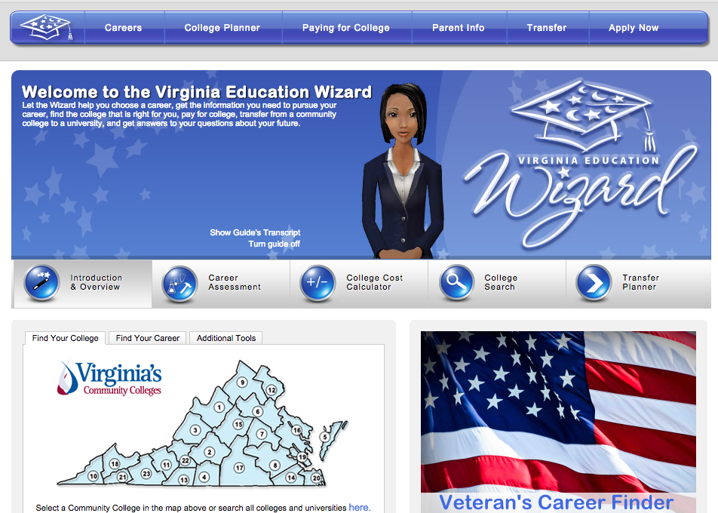

Slide 4
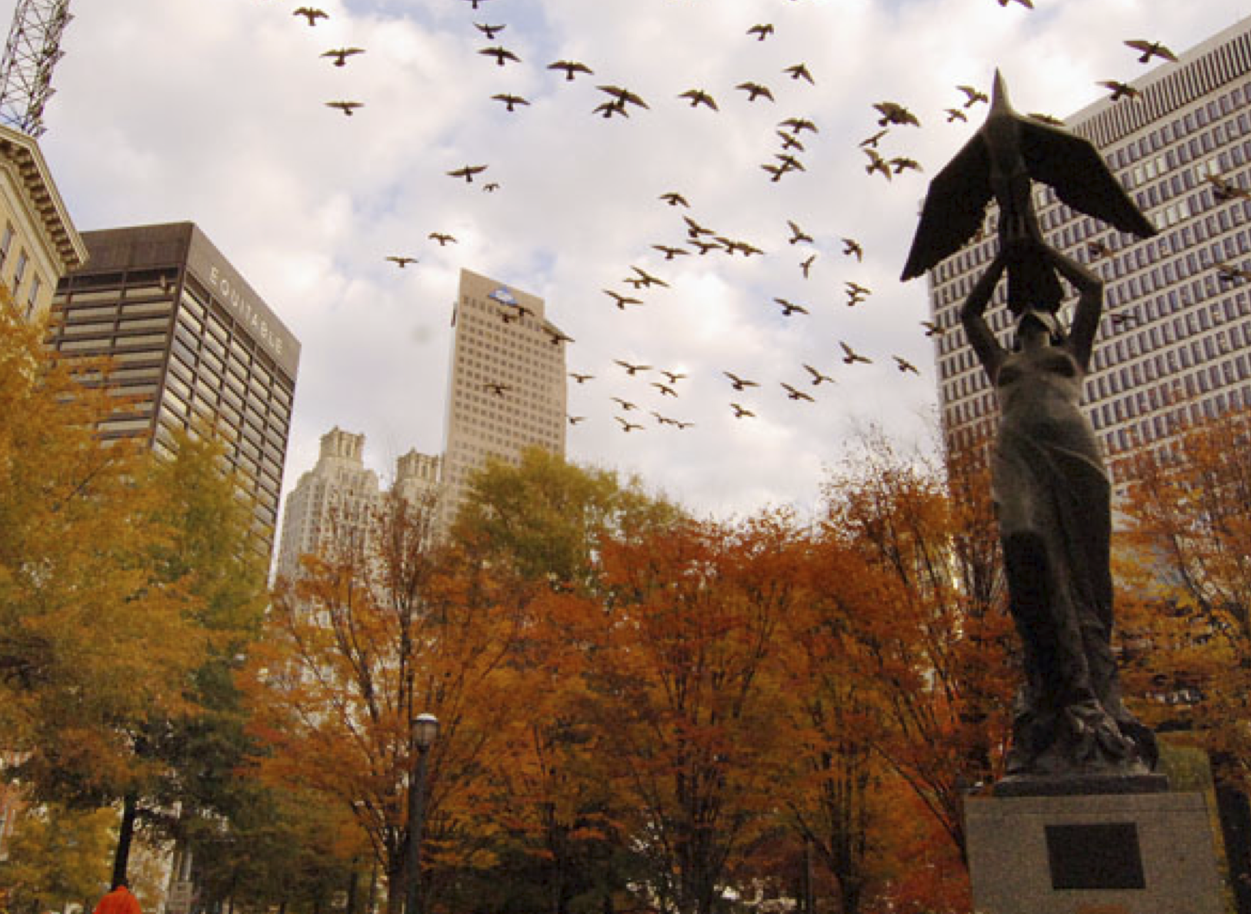
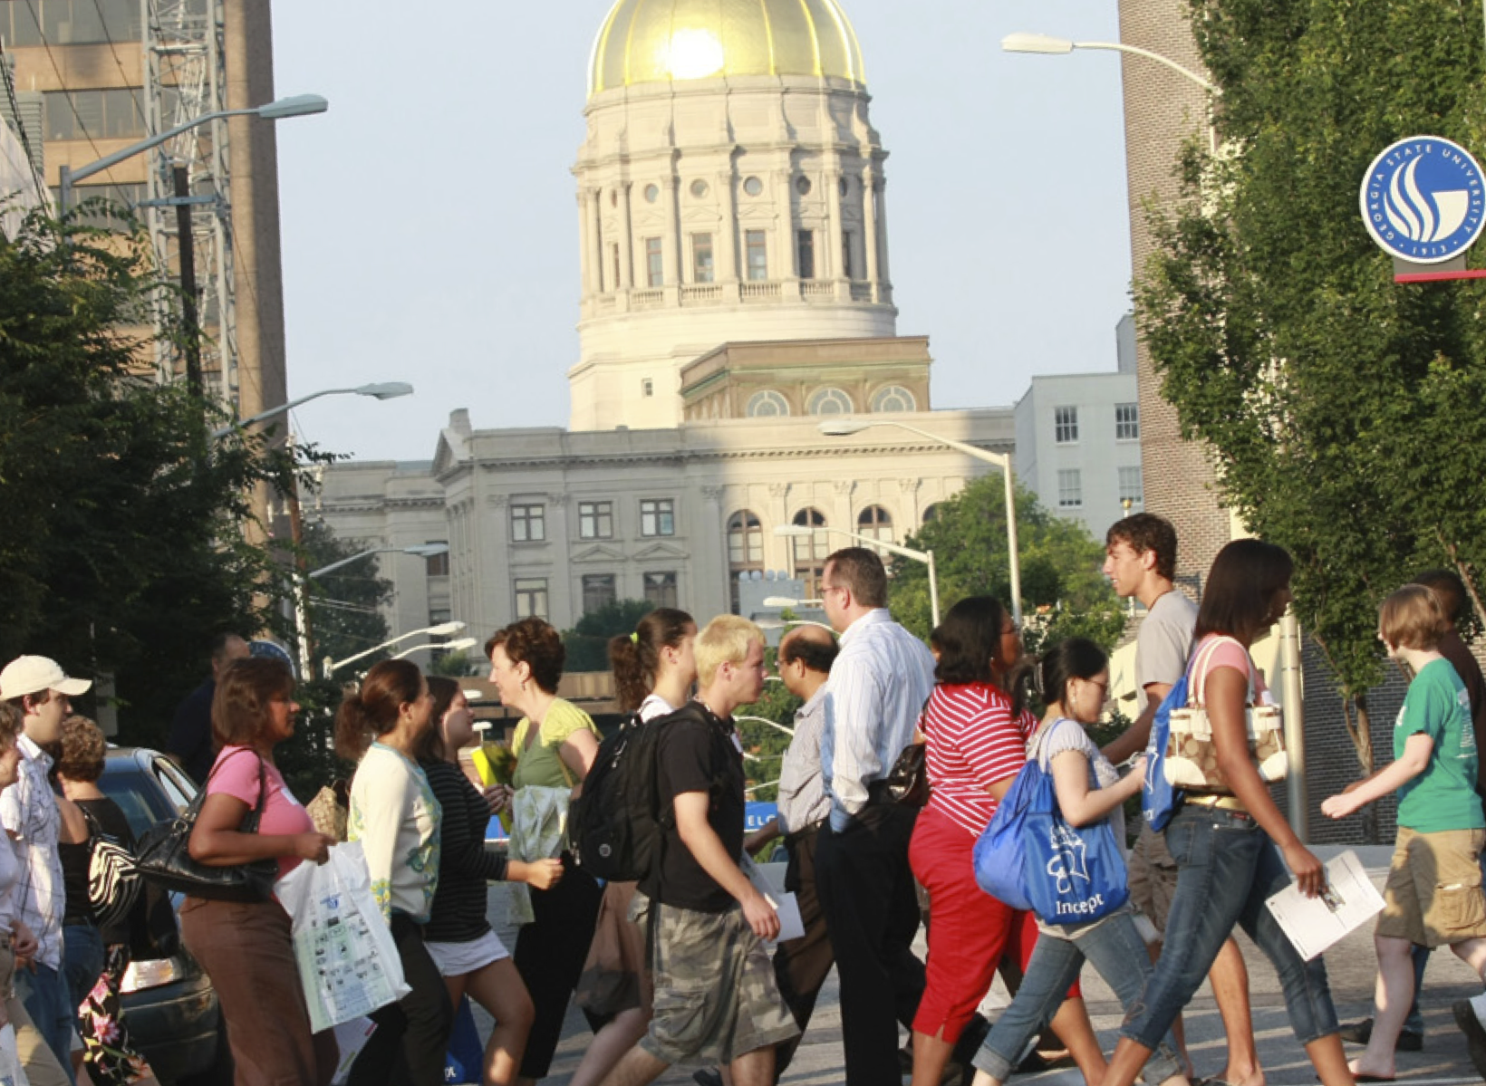
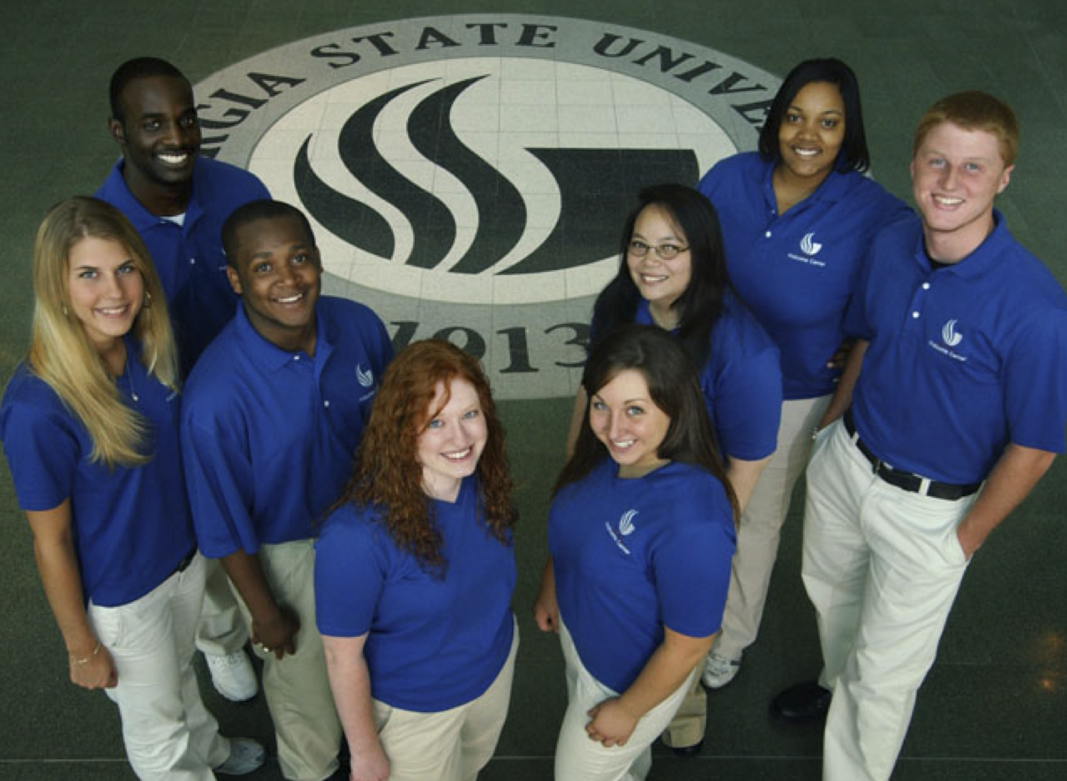


Complete College America
Miami December 1, 2014
Helping Students Make The Right Choices: GPS at Georgia State University
Timothy M. Renick, Ph.D.
Vice President for Enrollment Management & Student Success
Vice Provost

Slide 5
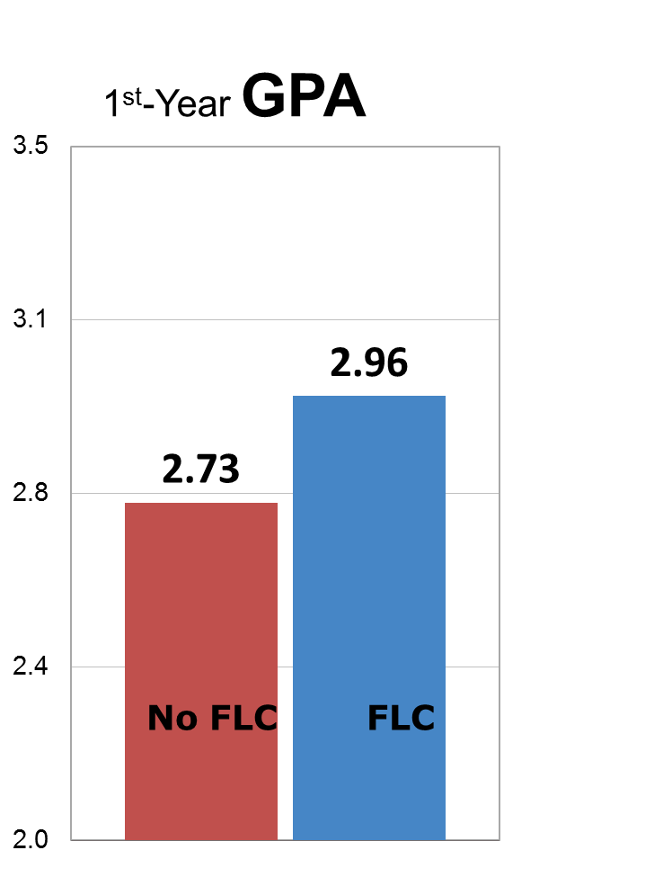
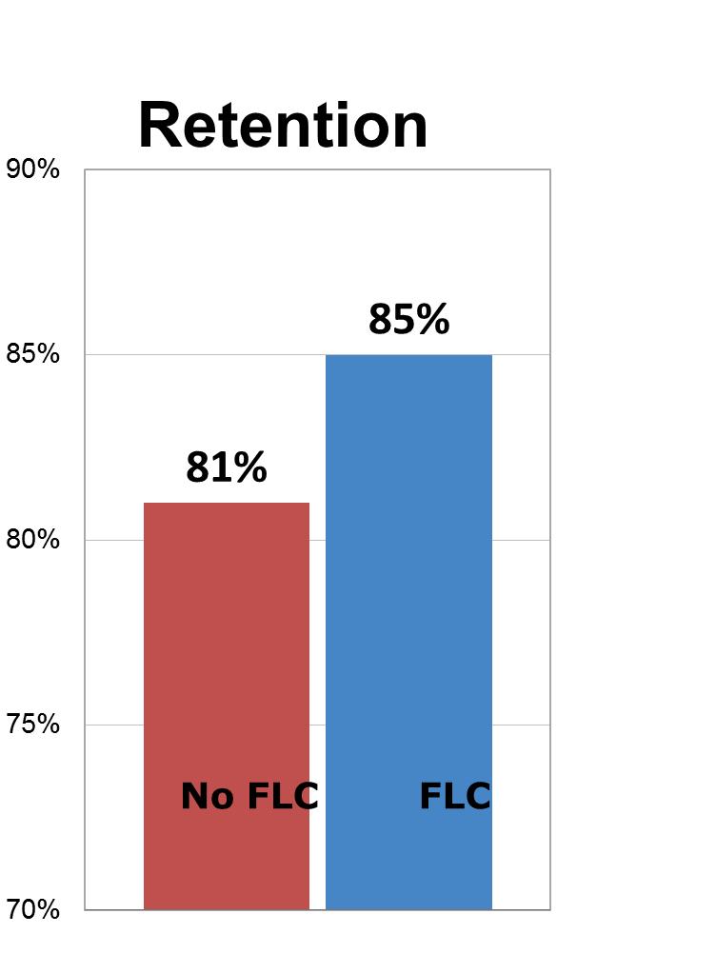
Freshman Learning Communities
Based on Meta Majors
Freshman Learning Communities with block schedules of 5 to 6 courses: 95% of non-Honors Freshmen
(Opt-out model)
Meta Majors:
STEM Business
Arts and Humanities Health
Education
Policy and Social Science
Exploratory
5

Slide 6
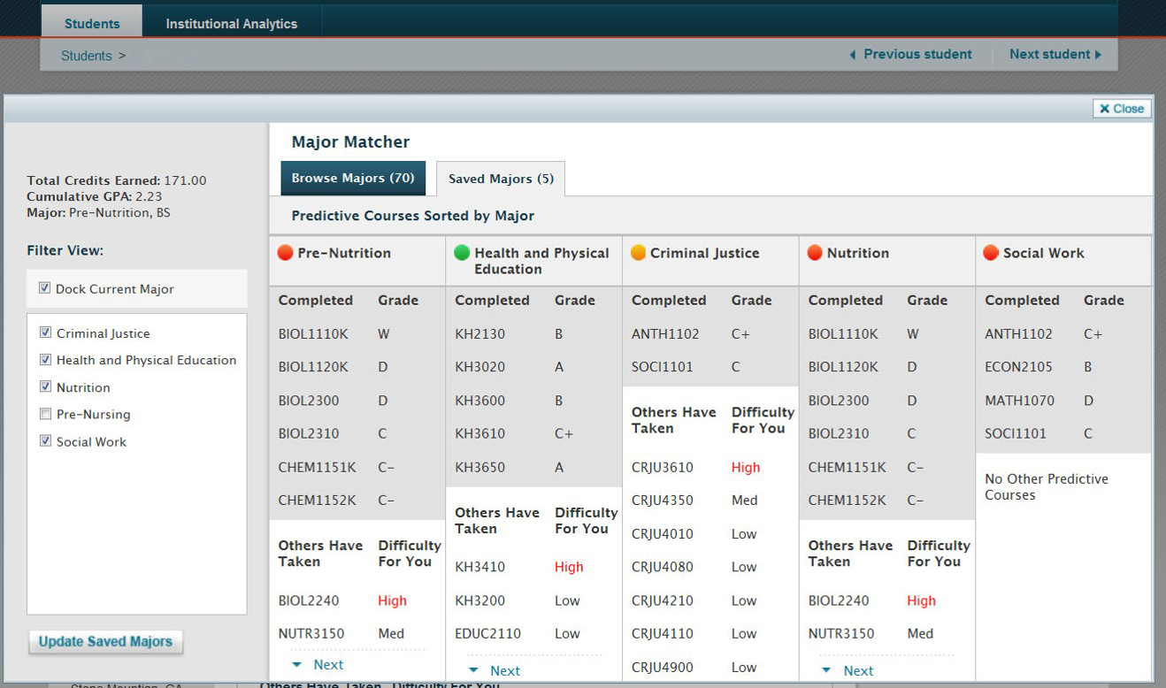
Advising: Major Matching
Predictive Analytics for Courses and Majors

Slide 7
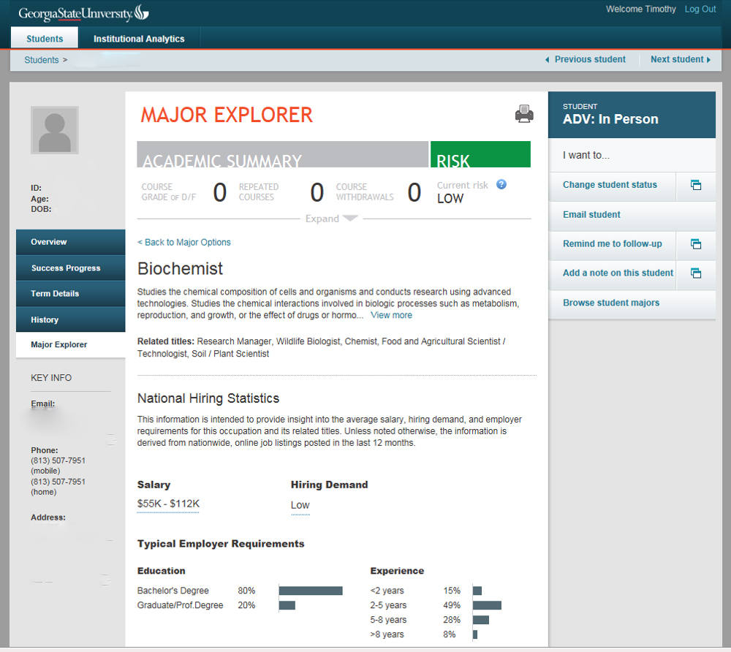
Advising: Career Pathways

Slide 8
Major Maps: Chemistry

Slide 9
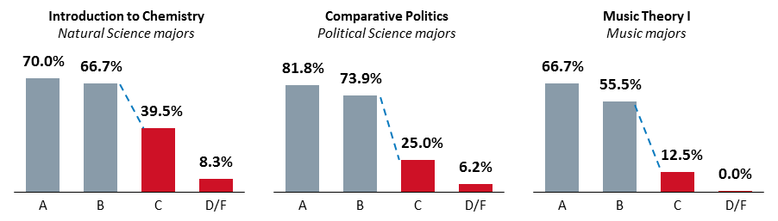
Alerts Based on Historical Data
Graduation Rate in Major by Introductory Course Grade

Slide 10
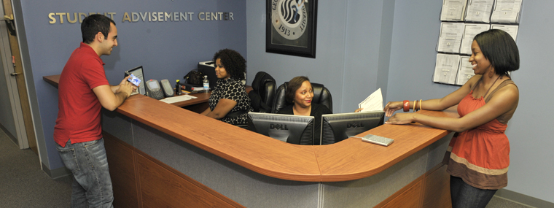
Advising Results: Large Impacts
University Advisement Center student visits in first 12 months: 33,979
Pre-Term Registration Corrections: 2,000+
Major Changes Advises: 6,536

Slide 11
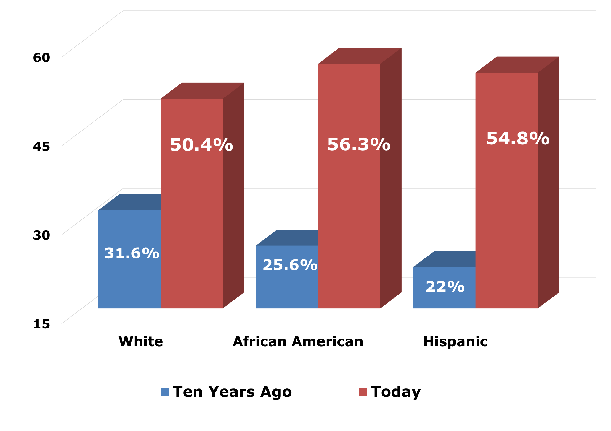
Graduation Rates by Race & Ethnicity

Slide 12

Making A Difference
Georgia State Degree Conferrals
2008 | 2009 | 2010 | 2011 | 2012 | 2013 | 5-Yr Change
5,857 | 6,188 | 6,419 | 6,901 | 7,365 | 7,590 | +30%

Slide 13

Bachelor’s Degrees Awarded by At-Risk Groups
 | 2009 | 2010 | 2011 | 2012 | 2013 | 2014 | 5-YR Change
AFRICAN AMERICAN | 1,067 | 1,001 | 1,322 | 1,440 | 1,550 | 1,692 | 59%
PELL | 1,066 | 1,298 | 1,648 | 1,835 | 2,007 | 2,058 | 93%
HISPANIC | 153 | 196 | 300 | 328 | 372 | 414 | 171%

