Slide 1

GPS IN STEM
Bruce Vandal | Vice President, Complete College America

Slide 2






The Essential Elements of GPS
Informed Choice and Meta Majors
Default Pathways
Math Aligned to Majors
Critical Path Courses
Academic Maps
Intrusive Advising

Slide 3
Students don’t ‘discover’ the right path; after choosing a major, the academic map is the default schedule.

Slide 4
Meta Majors
STEM
BUSINESS
HEALTH
SCIENCES
HUMANITIES
SOCIAL SCIENCES
ARTS
EDUCATION

Slide 5
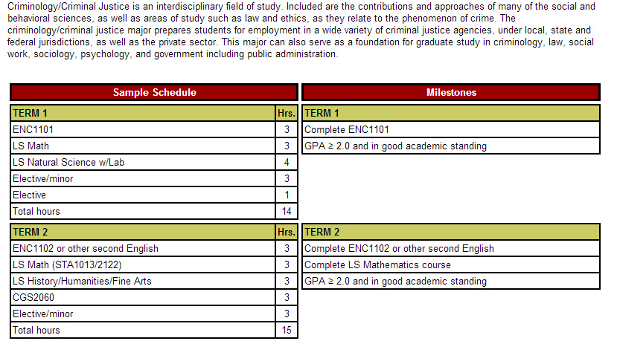
Academic Maps
4 essential components – the narrative, sample schedule, milestones and employment opportunities
The narrative explains the use of academic maps and any specific information about degree requirements, including admissions requirements
The milestones identify critical courses for timely progress and the last semester in which they can be completed for on-time graduation. Critical grades for Milestone courses may be included.
The sample schedule outlines which courses should be taken in which specific term in order to satisfy all requirements
List of Representative Job Titles and Potential Employers

Slide 6
Critical Path Courses
Prerequisite courses are designated for each semester.
They must be taken in the recommended sequence.
The college must guarantee the courses are available in the sequence and terms designed in the academic maps.

Slide 7
Intrusive Advising
Students must see their advisors before registering for classes if:
they do not complete the critical path course on schedule
they fall 2 or more courses behind on their academic map
they have a 2.0 GPA or less for the semester

Slide 8
Georgia State University
Degree maps and intrusive advising
Graduation rates up 20 percentage points in past 10 years
Graduation rates higher for:
Pell students, at 52.5%
African American students, at 57.4%
Hispanic students students, at 66.4%
More bachelor’s degrees to African-Americans than any other U.S. university

Slide 9
Florida State University
Since starting degree maps, FSU has cut the number of students graduating with excess credits in half
Graduation rate increased to 74%
African Americans to 77%
First-generation Pell students to 72%
Hispanic students to more than 70%

Slide 10
…What about STEM students?
Many Students are interested in STEM, but give up too soon.
Many take too few STEM credits.
Few complete college-level math their first year.

Slide 11
STEM Persisters Take A Higher Percent of STEM Courses Their 1st year
(NCES, 2013)

Slide 12
1st Year Bachelor’s STEM Persisters Complete College Math – Particularly Calculus
(NCES, 2013)

Slide 13
First Year Associate STEM Persisters Complete College Math
(NCES, 2013)

