Slide 1

FULL-TIME
IS 15

Slide 2
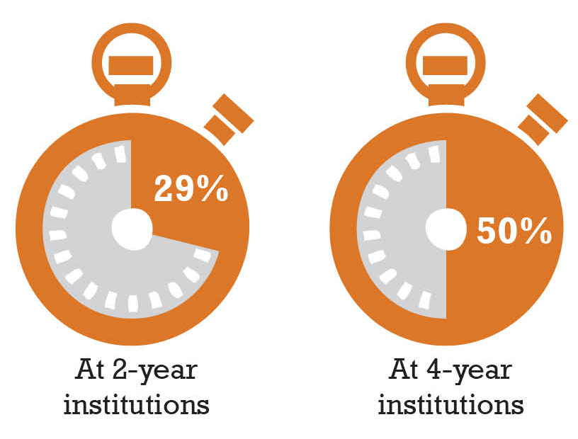
Most students DON’T take the credit hours necessary to graduate on time.
Full-time Students Taking 15+ Credits Per Semester

Slide 3
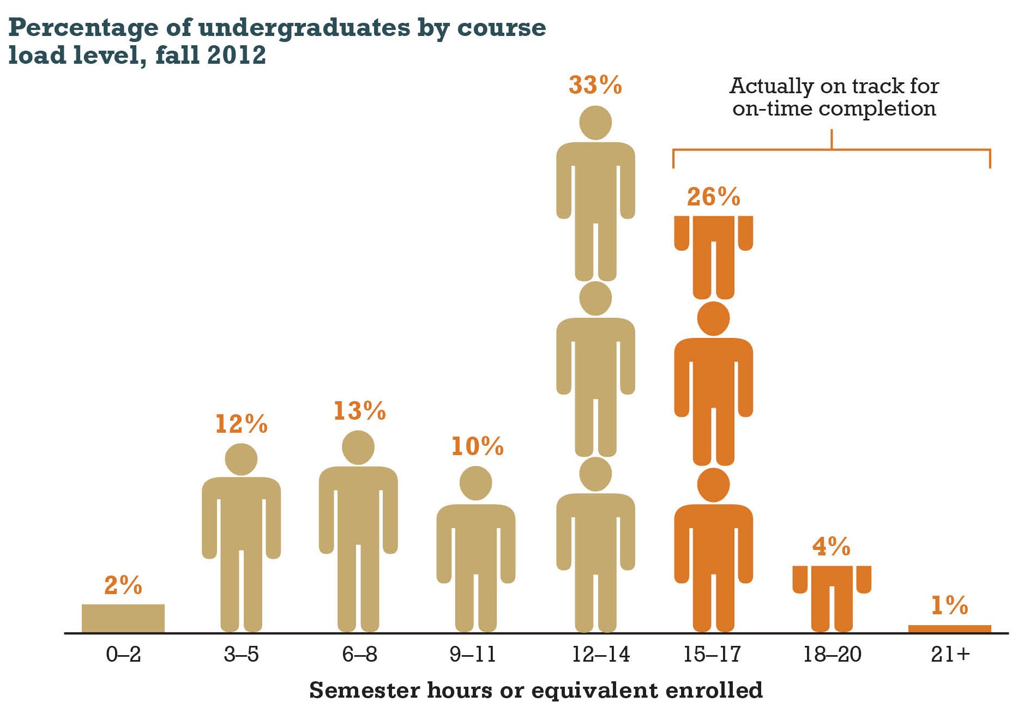
Most students DON’T take the credit hours necessary to graduate on time.

Slide 4
Tuition and aid policy at many four-year colleges works against 15-credit enrollment.

Slide 5
At community colleges, many students get paid NOT to take 15 hours.

Slide 6
States Where Low-Income Students are Really Full-Time

Slide 7
The Power of 15 Credits: More students graduate when they complete 30+ credits in their first year.

Slide 8


15 to Finish
Linda K. Johnsrud
Executive Vice President for Academic Affairs/Provost
Notes:
Aloha! Thank you for allowing me to share some information about the on-going Hawai‘i Graduation Initiative to you…the advisors…that help implement these initiatives. I am also very happy to continue my support for this conference now in its 5th year.
Let me first provide you with an overview of the public higher education agenda and where HGI fits in…

Slide 9

15toFinish.com
Notes:
The 15 to Finish campaign was launched to encourage students to take 15 or more credits per semester (or complete 30 credits in a year) in order to graduate on-time. It was targeted at freshmen since the majority of them already enrolled in 12-14 credits; however, the campaign impacted all students.
Hot off the press, here are some results for this fall (Fall 2013)

Slide 10
Percent Enrolled in 15 or More Credits
All UG Students | Fall 2011 | Fall 2012 | Fall 2013
UH System | 20.7% | 23.4% | 25.2%
UH Mānoa | 39.2% | 44.4% | 45.8%
UH Hilo | 36.6% | 39.3% | 40.6%
UH West O‘ahu | 19.7% | 25.1% | 29.2%
UH Community Colleges | 8.7% | 9.7% | 11.2%
Source: UH IRAO Base, Census
Notes:
Detailed tables can be found in your packet and on the 15 to Finish website.
Last year, the system increased the number of students taking 15 or more credits by 14.7% and this fall, we experienced another 5.2% gain.
Congratulations, all campuses experienced an increase in the percentage of students enrolling in 15 or more credits (even with some campuses experience slight enrollment decreases).
Systemwide, over a quarter of our students are now taking 15 or more credits.
Special shout out to West O‘ahu for having the highest numeric change in the number of all students taking 15 or more credits (151 students).

Slide 11
First-time Freshmen
 | UH System
 | Fall 2011 | Fall 2012 | Fall 2013
15+ credits | 1,360 | 2,102 | 2,279
% 15+ credits | 15.4% | 24.1% | 27.5%
12-14 credits | 4,823 | 4,200 | 3,981
% 12-14 credits | 54.7% | 48.3% | 48.1%
<12 credits | 2,635 | 2,402 | 2,017
% <12 credits | 29.9% | 27.6% | 24.4%
Source: UH IRAO Base, Census
Notes:
The 15 to Finish campaign focused on freshmen, especially those already taking 12-14 credits.
Systemwide, the percent of first-time freshmen taking 15 or more credits increased from 24.1% to 27.5% and the percentage of students enrolling in 12-14 credits decreased from 48.3% to 48.1% and less than 12 credits from 27.6% to 24.4%.
Special shout out to:
Kaua‘i and Windward who experienced the largest percent increase for freshmen enrolling in 15 or more credits – Kaua‘i went from 11.1% to 16.5% and Windward from 13.2% to 23.5%
Mānoa had the highest numeric increase with an additional 139 first-time freshmen enrolled in 15 or more credits. Mānoa now has 61.3% of their freshmen enrolled in 15 or more credits.

Slide 12
Retention of Freshmen (Fall 2012 to Fall 2013)
 | 12-14 Credits | 15 or more Credits
UH System | 62.2% | 75.9%
UH Mānoa | 73.3% | 82.2%
UH Hilo | 65.4% | 73.8%
UH West O‘ahu | 60.1% | 64%
UH Community College | 58.9% | 68.3%
Source: UH IRAO Base, Census
Retention at home campus only
Notes:
So, does taking 15 or more credits really matter?
This graph shows the retention rates of first-time freshmen that started in Fall 2012 and if they enrolled in Fall 2013 at the same campus.
The data continues to demonstrate that students enrolling in 15 or more credits are more successful. For the Fall 2012 semester, students enrolling in 15 or more credits have much higher retention rates than those enrolling in 12-14 credits across all campuses, four-year or CC.
Again, more detailed information with campus specific data can be found in your packets.

Slide 13
Thank you!
hawaii.edu/hawaiigradinitiative
15tofinish.com

Slide 14
UTAH’S FIFTEEN TO FINISH

Slide 15

UTAH’S FIFTEEN TO FINISH

Slide 16


