Slide 1

PERFORMANCE
FUNDING

Slide 2
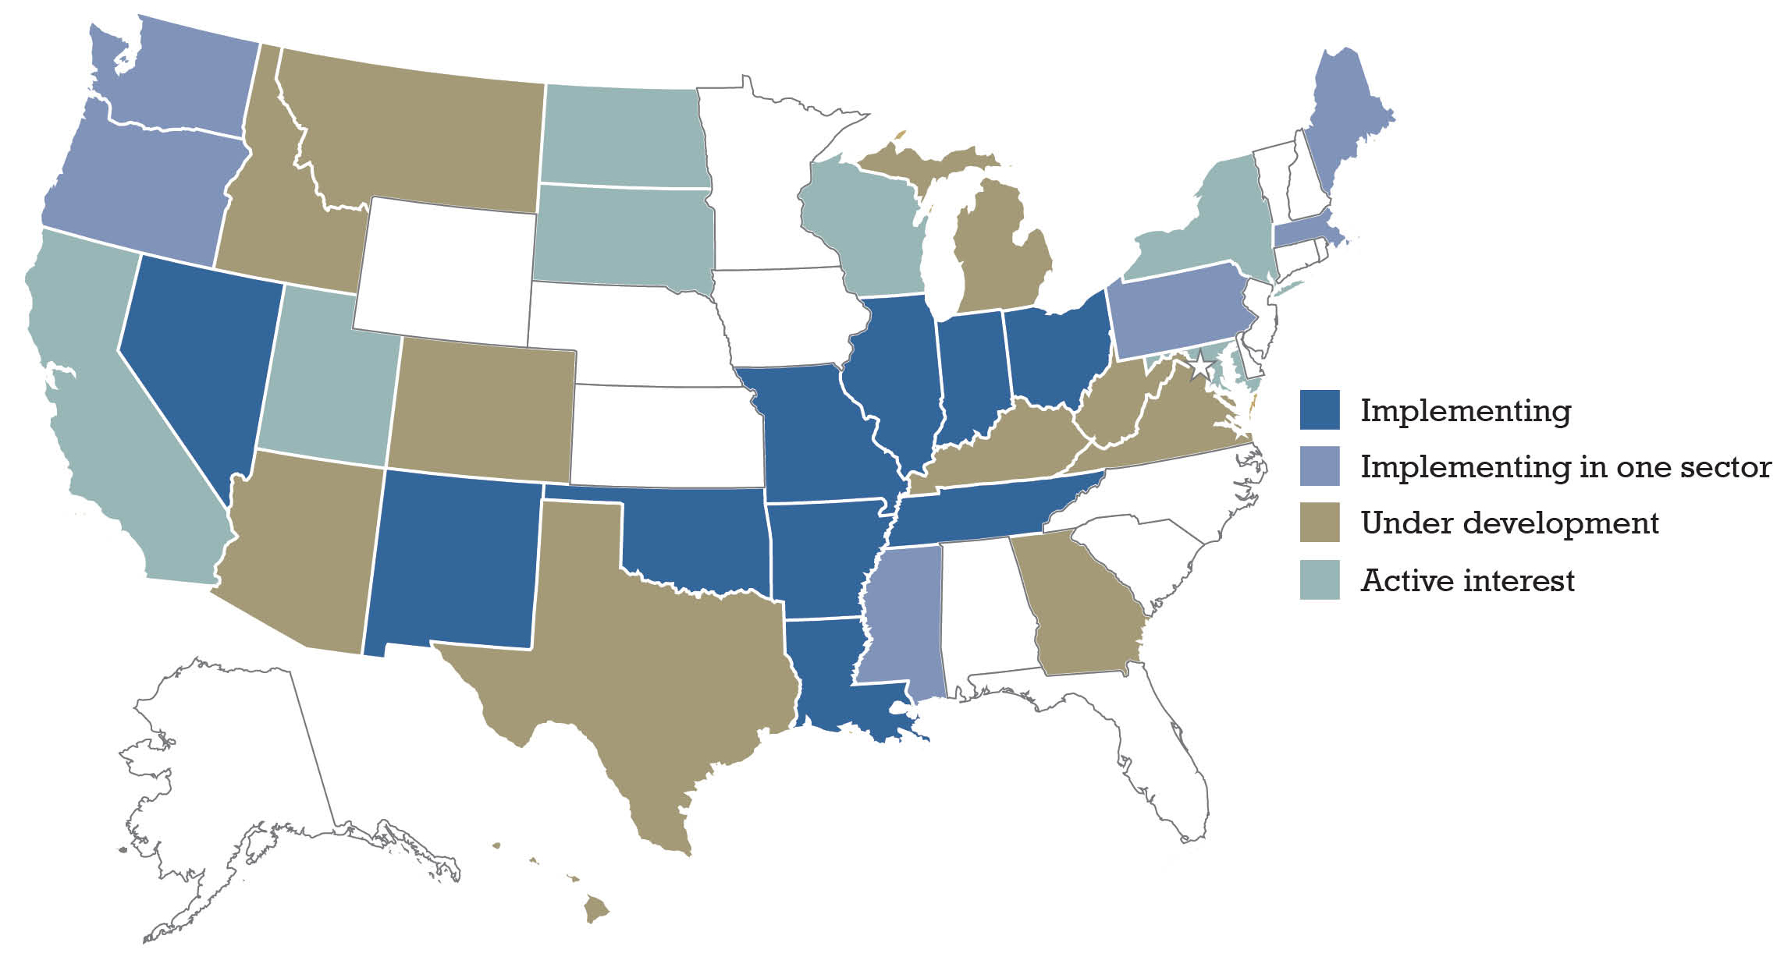
Performance funding is sweeping America.

Slide 3
Performance Funding Design Principles
Recognize that all funding models create incentives for institutional behavior.
Get agreement on goals before attempting to implement outcomes-based funding.
Include all public institutions in the model.
Design the model so it reflects and reinforces mission differentiation.

Slide 4
Performance Funding Design Principles
Include provisions that reward success in serving underrepresented populations.
Include provisions that reward progress as well as ultimate success (degree completion).
Limit the categories of outcomes to be rewarded.
Use metrics that are unambiguous and difficult to game.

Slide 5
Performance Funding Design Principles
Reward continuous improvement, not attainment of a fixed goal.
Address the quality issue.
Recognize that outcomes-based funding is but one piece of the overall financial model for any institution of higher education.
Outcomes-Based Funding:
The Wave of Implementation
Dennis Jones for Complete College America

Slide 6


