Slide 1

STRUCTURED
SCHEDULES

Slide 2
Where there is structure, there are significant results.
TENNESSEE COLLEGES OF APPLIED TECHNOLOGY
75%
avg. on-time graduate rate
TENNESSEE COMMUNITY COLLEGES
14%
avg. on-time graduate rate

Slide 3
Where there is structure, there are significant results.
ASAP PROGRAM
CITY UNIVERSITY OF NEW YORK
55%
3-year graduation rate for associate degrees
Doubled graduation rates using structured scheduling, whole programs
3X higher graduation rate than national avg. for urban community colleges

Slide 4
Where there is structure, there are significant results.
IVY INSTITUTE OF TECHNOLOGY PROGRAM
IVY TECH COMMUNITY COLLEGE SYSTEM
Structured career certificate programs in welding, machine tool, automotive, HVAC, mechatronics, and office technology.
85% completion
First Cohort:
90% retention
New Cohorts:

Slide 5
Where there is structure, there are significant results.
PROMISING PROGRAM: STRUCTURED
LEARNING COMMUNITIES
TENNESSEE COMMUNITY COLLEGES
As of Fall 2012:
  63 Structured Learning Communities statewide
  2,738 students enrolled
  3 certificates in General Ed for transfer students, career programs in Education and Business
  75% graduation/enrollment rate

Slide 6
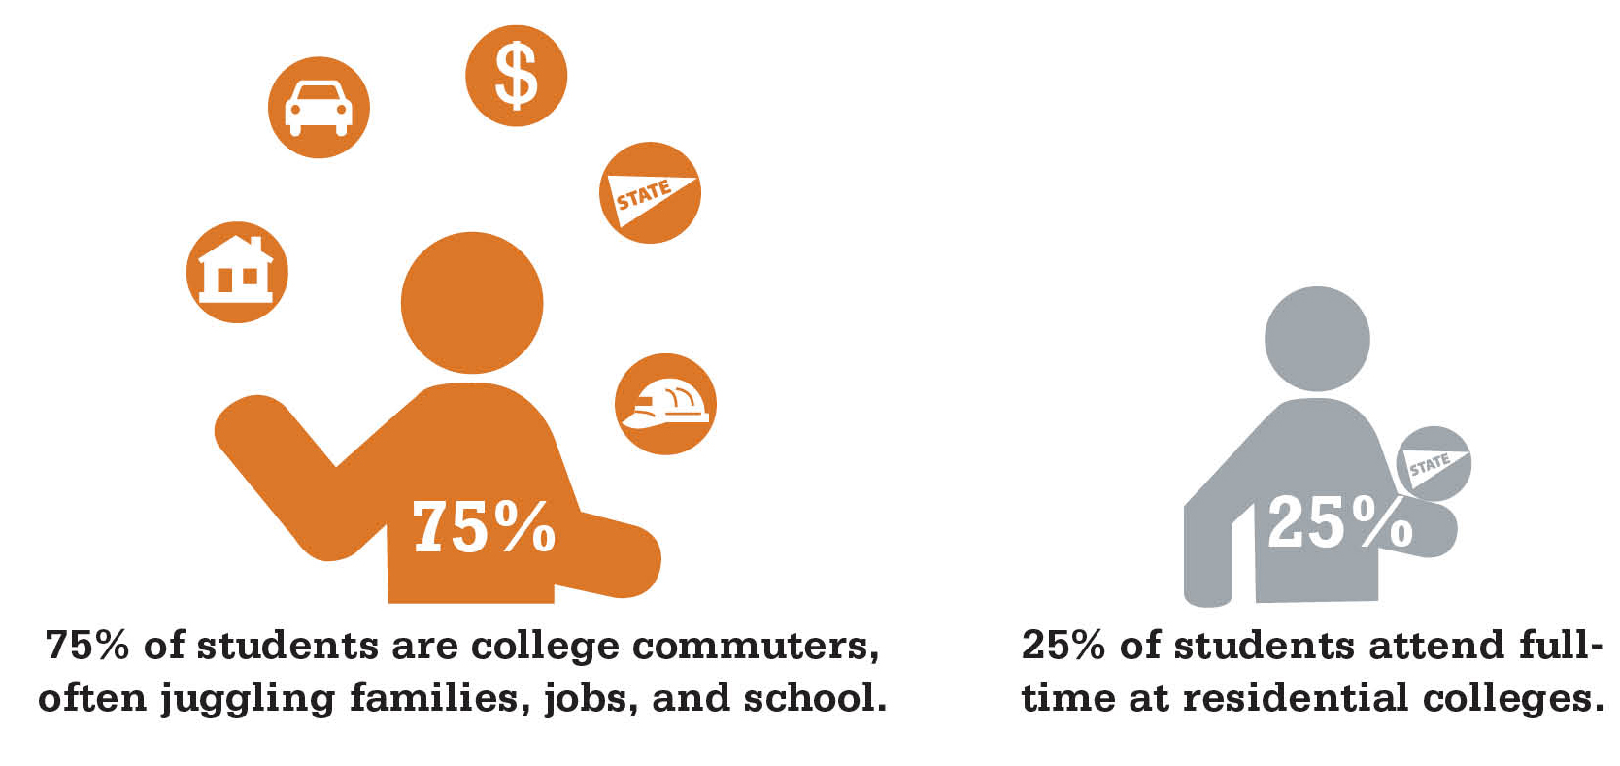
The New Majority

Slide 7
DISCONNECT
What Students Want for Success vs. What We Provide

Slide 8


Indiana’s Path
to Success:
Perspectives on Guided Pathways to Degree
Completion

Slide 9
PUBLIC AGENDA
Nonpartisan, nonprofit research and stakeholder organization that fosters progress on complex and divisive issues
Wide experience in higher education policy and practice
Focus on improving the quality and accelerating the pace of problem solving

Slide 10
PROJECT GOALS
Document advisor and student perceptions of obstacles to smooth pathways and timely completion
Probe advisor and student reactions to guided pathways policy proposals aimed at acceleration and preventing the accumulation of wasted credits

Slide 11
RESEARCH CONDUCTED
11 focus groups with:
  professional advisors
  faculty advisors
  current students
  non-completers
Broader context: 50 focus group conversations with 333 students in IN about barriers and enablers to transfer

Slide 12
CONTEXT: THE PARADOX OF CHOICE
Common belief: More choice = More freedom
Reality: Too many choices creates anxiety, leads to irrational decision-making processes.
Vast array of program and course choices contribute to student confusion, poor decisions and swirl.
Need for a more sensible “choice architecture” that empowers students to make good decisions.
Implications for Higher Education:

Slide 13
Overview of What We Heard
Students initially choose programs for which they are not suited,
Students make inappropriate course selections once in programs, slowing progress and undermining persistence
Advisors are overwhelmed, have difficulty providing effective guidance
Advisors report frequent information changes, tensions between faculty and professional advisors that cause mistakes in advising
Transfer students face particular challenges

Slide 14
REALITY: ADVISORS ARE OVERWHELMED.
What is the average ratio of advisors to students at public community colleges?

Slide 15
Advisors are overwhelmed.
“The ratio of student to advisor could be as high as 1100 to one. We try to give 30-minute appointments, but when it gets busy it could be 10 minutes.”
Guided Pathways to Success
Perspectives from Indiana College Students and Advisors

Slide 16
Advisors are overwhelmed.
“I think we’re in the mode of let’s get them out the door as quick as we can. The conversations go like this: Here’s what you need to take. You want this program? OK, boom, boom, boom. Now, is that going to interfere with your life? Oh, don’t worry. It’s okay.”
Guided Pathways to Success
Perspectives from Indiana College Students and Advisors

Slide 17
Students miss out on clear guidance.
“I think one of our biggest problems with advisors, though, is that they are swamped with students. They have so many students to get through.
…Go to this office, take a number, and get a random person, whoever was there that day at that time.”
Guided Pathways to Success
Perspectives from Indiana College Students and Advisors

Slide 18
Overview of Obstacles
Students make poor selection of initial program of study
Students make poor selection of courses once in program
Advisors navigate shifting requirements, poor channels of communication, large caseloads
Transfer students face especially daunting challenges

Slide 19
OBSTACLE:
POOR SELECTION OF INITIAL PROGRAM OF STUDY
Students lack goal clarity, are faced with a dizzying array of choices, have few resources to help find a good fit program
Advisors say caseloads are too large to give students adequate support, end up scheduling rather than advising

Slide 20
REALITY: SOME ADVISING PRACTICES
CAN MAKE MATTERS WORSE
What comes to mind when you consider the phrase “August train wreck”?

Slide 21
Some advising practices can make matters worse.
“In August, all bets are off. They throw the (admissions) rules out the window. They say, ‘Just register them. We need those numbers. Get them in here, get them in here, get them in here.’ We’re just registering…doing exactly what we were told.”
Guided Pathways to Success
Perspectives from Indiana College Students and Advisors

Slide 22
OBSTACLE:
POOR SELECTION OF COURSES ONCE IN PROGRAM
Students select courses that are not part of program or fail to take prereqs at appropriate time
Complex life situations make it hard for students to schedule courses when they are offered
Students self-advise based on inadequate or outdated information

Slide 23
OBSTACLE:
TRANSFER STUDENTS FACE DAUNTING CHALLENGES
Fragmented, incomplete, inaccurate or hard-to-access information on transfer
Advisors and students have difficulty determining which courses will transfer
Courses that do transfer often counted only as electives

Slide 24
REALITY: STUDENTS LIVE COMPLICATED LIVES.
What percentage of students at 2-year schools work 20 or more hours each week?

Slide 25
Students live complicated lives.
“It is insane. I mean – they’re dropping like flies, and it is like we don’t have anything on campus to anchor them. We don’t have people who are trained counselors, whose job is to help them through these things. They’re trying to juggle 18 balls in the air, and they’re trying to take 18 credit hours. They’re trying to work full-time, like, four jobs. They’re just stringing together tragedies and it’s difficult.”
Guided Pathways to Success
Perspectives from Indiana College Students and Advisors

Slide 26
GUIDED PATHWAY PROPOSALS REVIEWED
Proactive advising and informed choice
Degree maps and guaranteed courses
Block schedules and structured cohorts

Slide 27
PROPOSAL:
PROACTIVE ADVISING AND INFORMED CHOICE
Enthusiastic support for better advising technology
Hope that this will supplement and focus existing advising, rather than replace it
Interest in developing advising technology that also has accurate information on transfer articulation

Slide 28
Proactive Advising
“This would be wonderful. What is described here would be amazing. We can do some of this now but not in an automatic way. But right now we do that by pulling out their folder and going through every semester.”
Guided Pathways to Success
Perspectives from Indiana College Students and Advisors

Slide 29
PROPOSAL:
DEGREE MAPS AND GUARANTEED COURSES
Supported by many students and advisors
Concerns from small departments about ability to guarantee courses
Worries from two-year programs that students do not have time to explore

Slide 30
Degree Maps and Guaranteed Courses
“I think if they did something like take every degree there is and put them under, like, six fields, like a big umbrella. Then you can pick out which individual degree, if you know what you want. Then have something like a 101 class for each particular degree just to see, so students can test the waters to see if they even like it, and that would be their very first semester. That way they’re not wasting time.”
Guided Pathways to Success
Perspectives from Indiana College Students and Advisors

Slide 31
REALITY: STUDENTS LIVE COMPLICATED LIVES.
True or False: Students who have difficulty balancing work and school want more flexibility in their schedules.

Slide 32
Students want structure…
“That (block scheduling) would be fabulous – if you knew you could schedule your courses every semester at the same time, wouldn’t that be a dream come true?”
Guided Pathways to Success
Perspectives from Indiana College Students and Advisors

Slide 33
Students want structure…
“I actually like that approach because I’ve had the days where I go to class for an hour, and then I have two hours off. Well, I really don’t want to drive home just to drive all the way back. Yes, it might suck to be in class for four hours straight, but I could go into a job and say, “I go Monday through Friday from eight to noon but I can come in at one thirty or two o’clock and work with you guys.” I think employers would appreciate that more because I’ve actually missed out on a couple of jobs because of my school schedule.”
Guided Pathways to Success
Perspectives from Indiana College Students and Advisors

Slide 34
Advisors offer flexibility.
“A block schedule for a nontraditional student doesn’t work. You work. You have a family. They’re like, “I can’t take this course because it’s offered when I’m supposed to be working. If I don’t work, I can’t pay for school. If I can’t pay for school, then I can’t get a better job.”
Guided Pathways to Success
Perspectives from Indiana College Students and Advisors

Slide 35
PROPOSAL:
BLOCK SCHEDULES AND STRUCTURED COHORTS
Enthusiastically supported by many students (especially non-completers and those with complex lives)
Advisors concerned about negative impact on students with complex lives.
Concerns about implementation challenges
Concerns that this approach undercuts students learning self-management

Slide 36
RECOMMENDATIONS FOR ENGAGING STAKEHOLDERS
Communicate clearly about relationship between pathways efforts and other initiatives and priorities
Take concerns seriously and address them directly
Create opportunities for institutional stakeholders to deliberate about policy proposals and implementation obstacles
Include institutional stakeholders as partners in planning and implementation process

Slide 37
INDIANA’S PATH TO SUCCESS
Thank you!
For more information:
Alison Kadlec, Ph.D.
akadlec@publicagenda.org
www.publicagenda.org

Slide 38


