Slide 1
Proactive Advising for Momentum Pathways
Ashley Ruby
Nikolas Huot
September 16, 2019

Slide 2
Academic Advising
15 to Finish
Academic Maps
Corequisite Support
Math Pathways
Momentum Year
Adult Learners

Slide 3
ACADEMIC ADVISING
Academic advisors play an integral role in promoting student success:
Connect with students on a regular basis
Help identify pathways to academic and social success
Act as interpreters and advocates
Partners with faculty members, student affairs, and administration

Slide 4
ACADEMIC ADVISING
Improving academic advising processes is not a separate strategy. It is a structural change that is essential in order to ensure the implementation success of all Game Changers.
Academic advisors need to be involved in the all phases of planning and implementation.

Slide 5

ADVISING MODELS
Centralized
  Advising Center Only
Decentralized
  Faculty Only
Shared
  Supplementary
  Split
Other Considerations
  Peer advising
  Online
  Reporting structure
Notes:
Centralized: where professional and faculty advisors are housed in one academic or administrative unit. Self Contained Model, frequently used at 2-year, professional advisors only
Decentralized: professional or faculty advisors are located in their respective academic departments. Faculty only model, frequently used at private institutions.
Shared: where some advisors meet with students in a central administrative unit (i.e., an advising center), while others advise students in the academic department of their major discipline. Supplementary model, centralized unit supports program advising. Split model, faculty and advising center for specific subsets, dominant at 4-year public.
Variables to consider when choosing a model:
Enrollment
Administrative structure of the institution
Faculty interest and willingness
Academic policies, curriculum, and degree programs
Institutions mission
Composition of student body
Culture of institution
How to determine effectiveness:
Are advisors accessible
Are resources available to support structure
Are reporting structures clear
Is it clear to students
Do advisors understand structure
Promote communication
Conducive to sharing information

Slide 6

CHALLENGES
Inconsistencies in service provided
Lack of professional development opportunities
Prioritization of advising
Advisee caseload
Resources
TIME!!!

Slide 7
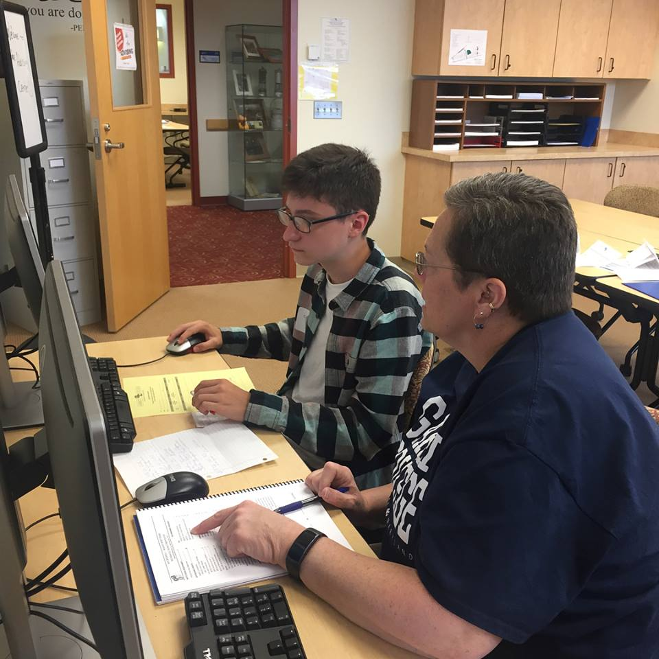
ADVISING AT GARRETT COLLEGE
Centralized Hybrid Advising Model
  Advising & Academic Success Center
    Academic Success Advising
    New Student Advising and onboarding
    Career Advisement
    Transfer Advisement
    Academic Support Services
    Testing Center
    STARS Program
    Learning Commons integration
  Program-Specific Faculty Advising

Slide 8
ADVISING AT GARRETT COLLEGE
Advising Syllabus
  Definition
  Mission
  Expectations
  Responsibilities
Credits | You should be able to… | Recommended actions | Your reward
By about 12 credits | Identify your interests, skills, and values to assist you in formulating goals. Make a tentative educational plan. | Take a career assessment to identify/verify your career goals. Create a tentative educational plan. Meet with your faculty advisor to review plan. Get Involved in Campus Activities. | Knowing how to get around the campus to find what you need.

Slide 9
ADVISING AT GARRETT COLLEGE
“Today I was treated like a person and not like a number. I really like the staff here.” [Onboarding Advising]
“My advisor is very helpful in making sure that I stay on track with my major and that I am taking the classes I need in a timely manner.” [In-Term Advising]
“My advisor was extremely helpful in helping me figure out how to work in all my classes and still be able to work full-time! It meant a lot that he did that for me!!” [Add/Drop]
“I had so many question before attending the advising day and I am so happy that I got all of them answered so I won't go home unsure of anything.” [Onboarding Advising]
 | Academic Advising | Career Counseling
Pre AASC | 32.9% | 13.7%
Post AASC | 41.9 | 17.5%
Notes:
Community College Survey of Student Engagement to evaluate student satisfaction, importance, and frequency of use pre and post AASC
27% increase in average responses pre to post of students very satisfied with academic advising and planning services
Consistently 3-5% points above the average of small colleges and 8-10% points above the average for all colleges
28% increase in average responses pre to post of students very satisfied with career counseling services
Rating of importance and frequency of use statistics also trend upward from pre to post
Survey also assesses support services (tutoring) if services are integrated

Slide 10
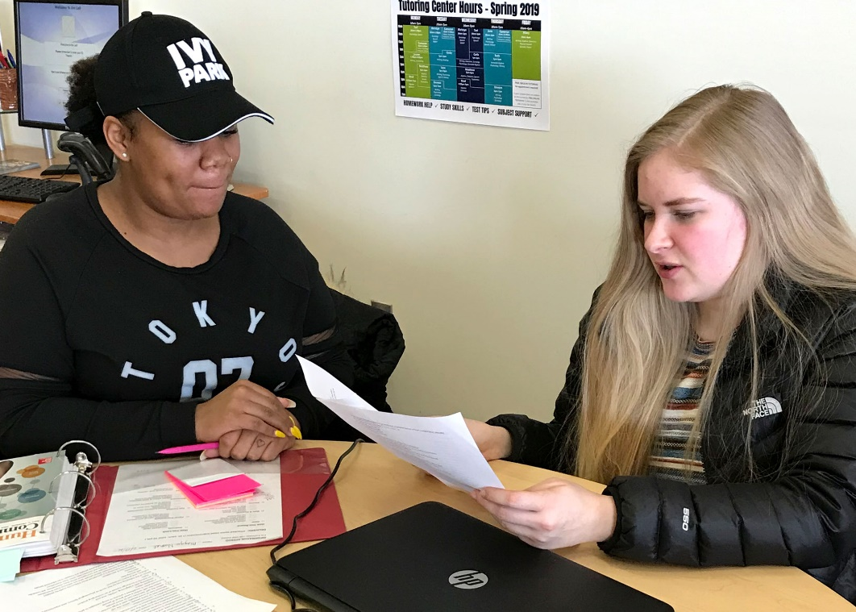


ADVISING & ACADEMIC SUCCESS CENTER
Satisfaction ↑ 27%
Tutoring ↑ 23.8%
Advising visits ↑ 200%
Midterm deficiencies ↓ 2.1%
Academic difficulty ↓ 5.46%
Academic dismissal ↓ 1%
LOWEST IN 14 YEARS!
Notes:
Implementation
27% increase in student satisfaction with Academic Advising (CCSSE)
23.8% increase in tutoring use
92.4% increase in tutoring time spent
200% increase in advising use
300% increase in advising visit frequency
Student Outcomes
2.1% reduction in student midterm deficiencies (all students)
9.6% reduction in resident student midterm deficiencies, REVERSING AN INCREASING TREND
5.46% reduction in academic difficulty status (pre to post AASC averages)
1% reduction in academic dismissal status (pre to post AASC averages)
LOWEST IN 14 YEARS
2% increase in fall to spring retention
8% increase in fall to fall retention
Ripple effect
5% increase in GRATUATION RATES since the launch of the AASC!!!

Slide 11
HIGH IMPACT ADVISING APPROACHES
Prescriptive
Developmental
Learning-Centered
Strengths-Based
Proactive (Intrusive)
Appreciative
Social-Constructivist
Notes:
Prescriptive - Prescriptive advising, based on the work of Crookston, represents a traditional relationship based on authority between the academic advisor and the student. Doctor/patient relationship. Approach doesn’t encourage student to develop a sense of responsibility.
Developmental – Crookston, three of Chickering's developmental vectors in particular: developing competence, developing autonomy, and developing purpose. O'Banion's five steps in the dimensions of the advising process: '(1) exploration of life goals, (2) exploration of vocational goals, (3) program choice, (4) course choice, and (5) scheduling courses
Learning-Centered - Based on Crookston's belief in 'advising as teaching', this approach places the teaching aspect of academic advising at the forefront
Strengths-Based - Schreiner and Anderson, rather than focusing on remediating individuals' 'deficits' and weaknesses or problems, strength-based advising shifts the focus of the advising sessions from areas of need to areas of talent and engagement
Appreciative – Based on appreciative inquiry, Appreciative Advising is the intentional collaborative practice of asking positive, open-ended questions that help student optimize their educational experiences and achieve their dreams, goals, and potentials
Intrusive/Proactive – At risk groups, since many under-prepared first-year students are unlikely to seek academic and personal assistance of their own volition, intrusive advising is an effective method in which the advisors and the institution take the initiative in providing support services to help these students succeed. Proactive Advising involves:
deliberate intervention to enhance student motivation,
using strategies to show interest and involvement with students,
intensive advising designed to increase the probability of student success,
working to educate students on all options, and
approaching students before situations develop.
Caring relationship that leads to increased academic motivation and persistence
Social-Constructivist - Many non-Western cultures, which tend to value 'community over self and personal relationships over individual achievement‘. These students may require a different advising approach which enables them to interact collaboratively and cooperatively.

Slide 12
PROACTIVE ADVISING
Deliberate, structured student interventions
Purposeful, structured involvement with students
Efforts to reach out to students before they ask for help
Inquiries into causes of the students’ concerns/difficulties
Notes:
Proactive Advising Defined “Earl (1988) describes Proactive Advising as a deliberate, structured student intervention at the first indication of academic difficulty in order to motivate the student to seek help. Proactive Advising uses the good qualities of prescriptive advising (experience, awareness of student needs and structured programs) and of developmental advising (relationship to a student’s total needs).” –Varney, 2012 Purpose: To help students persist to graduation

Slide 13
PROACTIVE ADVISING - Student Contact Plan
Weeks 1-2
Meet and greet activity
Visits to developmental and college level English, Math, and Reading courses
Weeks 3-5
Introductions and check-in with all advisees
Meet with second semester advisees to discuss career and transfer goals
First Year Experience tours of AASC
Meet with advisees on Academic Probation
Meet with advisees that have had Financial Aid reinstatement
Administer study skills and motivational assessment to First Year Experience students
Meet with advisees on Academic Probation
Execute interventions for Early Academic Alerts
Schedule Adjustments
Notes:
Proactive Advising is the core of advisor’s work with students at my institution. The mission of academic, personal, career and transfer advising at my institution is to effectively assist students in the development of meaningful educational and life plans that are consistent with their aspirations, interest, skills, and work and life values and in the implementation of these plans through purposeful major selection, successful degree completion, smooth transferring to 4-year institutions, honest personal reflection, and relevant work and service learning experience. Since the start of the Advising & Academic Success Center, and when I began my work as an advisor, students experience early and frequent Academic Advisor contact through personal outreach, academic interventions, and engagement activities per the AASC contact plan. The AASC is also heavily involved in the First Year Experience courses in which advisors utilize career planning tools, long-term academic planning strategies, study skills workshops, and general academic advising know-how. Academic advisors have specific checkpoints throughout the semester at which they meaningfully engage with students. This is outlined in a student contact plan; an example is shown here. Advisors track data on each student interaction for assessment purposes.
Anticipate needs and connect to appropriate resources and support early.
In-term student contact plan (snippet)
Full plan extends through entire semester
Similar plan exists for new student onboarding

Slide 14
PROACTIVE ADVISING -
Early Alert
First Occurrence
FACULTY: Contact student before next class (phone or email) to discuss issue
Second Occurrence
FACULTY: submit
ALERT #1
Fourth Occurrence
Continual or Habitual Occurrences
CARE: alerted, outreach to student
FACULTY:
submit
ALERT #3
FACULTY:
submit
ALERT #4
ADVISOR: intrusive/intentional contact
RES HALL: alerted, contact student
ADVISOR: intrusive/intentional contact
FINANCIAL AID & BUSINESS OFFICE: alerted, contact student
Third Occurrence
FACULTY:
submit
ALERT #2
ADVISOR: contact student by email or phone
ADVISOR: contact student by email or phone
CARE: alerted
RES HALL: alerted, contact student
RES HALL: alerted, contact student
JOINT MEETING
ATHLETICS: alerted, contact student
ATHLETICS: alerted, contact student
ATHLETICS: alerted, contact student
FINANCIAL AID & BUSINESS OFFICE: alerted
FINANCIAL AID & BUSINESS OFFICE: alerted, contact student
CARE: alerted, outreach to student
ACADEMIC CONCERNS:
  Class absence
  Missing assignment
  Low test/quiz score

Slide 15

PROACTIVE ADVISING – Interventions
Email
Phone call
Intentional contact
  Find on campus, hallway or between classes
Intrusive contact
  Pull out of class
Require meeting with advisor
Complete Academic Success Contract
Complete Gameplan for Academic Success
Complete Motivation Assessment
Notes:
Often, these interventions include personal referrals to services available on and off campus. Sometimes, advisors need to include other individuals on-campus to assist the student, such as athletic coaches, residence hall staff, and financial aid. This holistic approach to student academic, social, and emotional support is keystone at our small instution.

Slide 16

PROACTIVE ADVISING - Referrals
Academic Support Services
  Tutoring Center
  Online Tutoring
  Student Success Workshops
  Academic Skills Review session with an Advisor
  Testing Center
  Research Support (Library)
Disability Services
Financial Aid
Emergency Student Funds
Community Mental Health Resources
Other Campus and Community Resources

Slide 17
EARLY ALERT
Alert Saturation
  13-16% of students receive an alert
  87% of those are alerted multiple times
Student Outcomes
  36% demonstrate academic improvement
  61% retention rate for alerted students
Early Academic Alerts
Timely intervention • Swift follow-through • Prompt feedback
Notes:
On average…
The percentage of the student body receiving an alert ranges from 13% to 16% each semester
87% of those students receive multiple alerts in the same semester
On average…
36.3% of alerted students show some measure of improvement during the alerted semester
32.5% are assigned the status of good academic standing at the end of their alerted semester
61.3% of alerted students are retained into the immediately following semester

Slide 18

PROACTIVE ADVISING - Appreciative Advising
“Appreciative Advising is the intentional collaborative practice of asking positive, open-ended questions that help student optimize their educational experiences and achieve their dreams, goals, and potentials.”
Dr. Jenny Bloom
Notes:
THE SIX PHASES
Disarm: Make a positive first impression with the student, build rapport, and create a safe, welcoming space.
Discover: Ask positive open-ended questions that help advisers learn about students' strengths, skills, and abilities.
Dream: Inquire about students' hopes and dreams for their futures.
Design: Co-create a plan for making their dreams a reality.
Deliver: The student delivers on the plan created during the Design phase and the adviser is available to encourage and support students.
Don't Settle: Advisers and students determine to set their own internal bars of expectations high

Slide 19

PRACTICES TO IMPLEMENT TOMORROW
How Advisors support MOMENTUM PATHWAYS
    Academic Maps
      Proactive Advising
        Informed academic decisions
          15 to Finish
            Gateway course completion
Notes:
DISCOVER YOUR ACADEMIC ADVISING PHILOSOPHY
Awareness of one’s own personal philosophy of academic advising provides a solid foundation for advising practice and enables the advisor to examine and improve their relationships with and the outcomes for students.
Your conception of advising
A description of how you advise
The rationale for why you utilize this philosophy

Slide 20
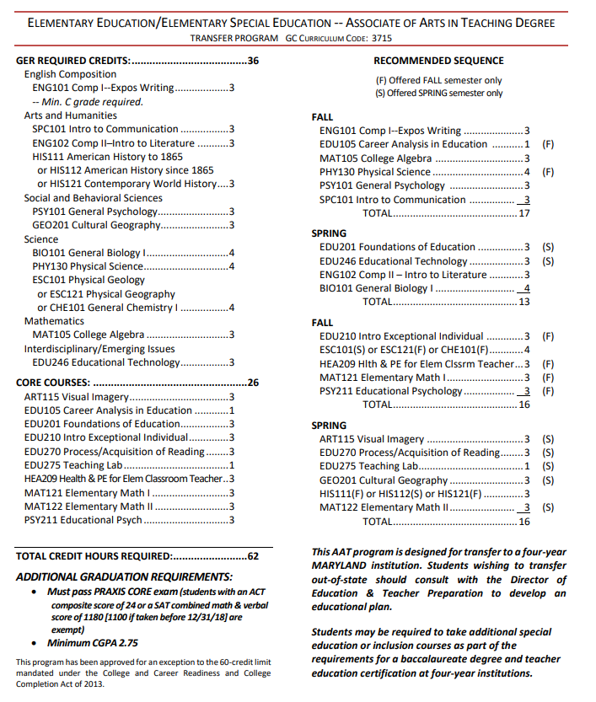
ACADEMIC MAPS
15 credits
Gateway course completion
Program credits in first year
Sequencing
Career information
Program specifics
Advising notes
Notes:
Do you have maps?
Do they make sense?
Do advisors use them?
Do students use them?

Slide 21


INFORMED ACADEMIC DECISIONS
Career assessment
Access to career-related information
Academic programs connected to careers

Slide 22

ADVISOR PRESENCE
Orientation
Onboarding
Meet and greet activities
Career assessment
First Year Experience course
Mandatory meetings
Goal-setting

Slide 23

ADVISOR INITIATED OUTREACH
Phone calls
Targeted emails and text messages
Periodic check-ins
Midterm grade review
Early Alerts

Slide 24


PROACTIVE ADVISING - Appreciative Advising
What does your office look like?

Slide 25

PROACTIVE ADVISING - Appreciative Advising
What grade would you talk about first?
English A
History A
Biology B
Phys Ed B+
Math F
Notes:
About 80% of parents will acknowledge the failing grade first. Start with the A and B grades. The answer to the F lies within the As. What if they were all Fs? Has the student lost his or her academic mojo? Reflect on the last time they were academically successful.

Slide 26
CONTACT PLAN
Weeks 1-2
Meet and greet activity
Visits to developmental and college level English, Math, and Reading courses
Weeks 3-5
Introductions and check-in with all advisees
Meet with second semester advisees to discuss career and transfer goals
First Year Experience tours of AASC
Meet with advisees on Academic Probation
Meet with advisees that have had Financial Aid reinstatement
Administer study skills and motivational assessment to First Year Experience students
Meet with advisees on Academic Probation
Execute interventions for Early Academic Alerts
Schedule Adjustments
Develop a
Contact Plan
Purpose
Frequency
Audience
Method
Notes:
Text message example: ABC…what'

Slide 27
CONTACT PLAN
Weeks 1-2 (Orientation, classes begin,
schedule adjustment period)
Be visible on campus, say hello to students, introduce yourself
Ensure office is clearly marked with your name, contact information, and office hours
Hold/announce open-door office hours
Email introductory message to all advisees; invite advisees to come meet you
Call upcoming graduate advisees to ensure they are enrolled in remaining program requirements
Respond to emails and return calls from advisees
Develop a
Contact Plan
Purpose
Frequency
Audience
Method

Slide 28
TEXT MESSAGE
Can you figure out the the mistake?
ABCDEFGHIJKLMNOPQRSTUVWXYZ
When you have an answer, come to Garrett College, Room 519, for a chance to earn $100,000!

Slide 29
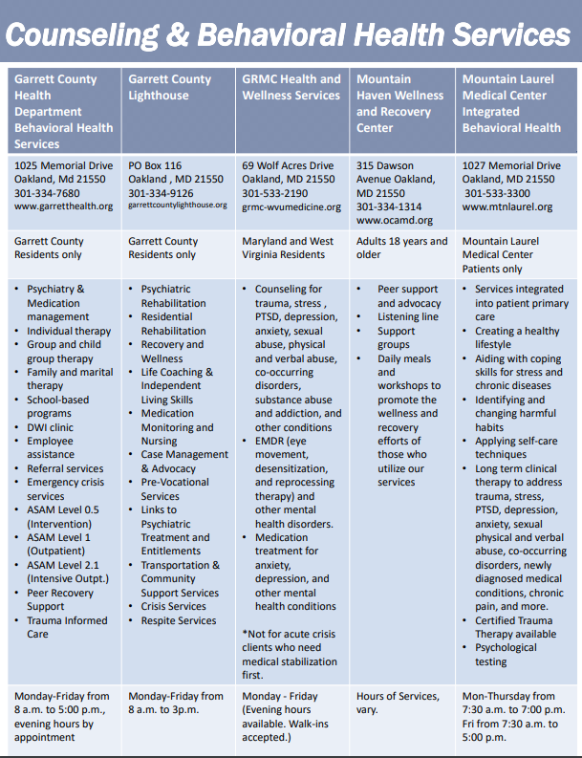

KNOW YOUR RESOURCES
College Catalog
Degree Audit
Student Portal
Registration
Career Assessment
Transfer Tools
Notes:
Create and distribute a resource toolkit to all advisors

Slide 30

NACADA
NACADA is an association of professional advisors, counselors, faculty, administrators, and students working to enhance the educational development of students.
Notes:
NACADA is an association of professional advisors, counselors, faculty, administrators, and students working to enhance the educational development of students.
NACADA promotes and supports quality academic advising in institutions of higher education to enhance the educational development of students. NACADA provides a forum for discussion, debate, and the exchange of ideas pertaining to academic advising through numerous activities and publications. NACADA also serves as an advocate for effective academic advising by providing a Consulting and Speaker Service, anAwards Program, and funding for Research related to academic advising.
NACADA evolved from the first National Conference on Academic Advising in 1977 and has over 12,000 members representing all 50 United States, Puerto Rico, Canada, and several other international countries. Members represent higher education institutions across the spectrum of Carnegie classifications and include professional advisors/counselors, faculty, administrators and students whose responsibilities include academic advising.
NACADA functions with volunteer leadership with support from the NACADA Executive Office. Members have full voting rights and elect the national board of directors as well as other leaders within the organization. NACADA is designated by the IRS as a 501(c)3 non-profit educational association incorporated in Kansas.

Slide 31

NEXT STEPS

Slide 32
WORKS CITED
Academic Advising: A Comprehensive Handbook, edited by Virginia N. Gordon and Wesley R. Habley, was published.92
Bloom, J. L., Hutson, B. L., & He, Y. (2008). The appreciative advising revolution. Champaign, IL: Stipes Publishing.
Justyna, E., & Daly Cofer, R. (2010, March). Ten 'must have' tips for new (and not so new) academic advisors. Academic Advising Today, 33(1). Retrieved from https://www.nacada.ksu.edu/Resources/Academic-Advising-Today/View-Articles/Ten-Must-Have-Tips-for-New-and-Not-So-New-Academic-Advisors.aspx
NACADA. (2003). Paper presented to the Task force on defining academic advising. Retrieved from NACADA Clearinghouse of Academic Advising Resources website: https://www.nacada.ksu.edu/Resources/Clearinghouse/View-Articles/Definitions-of-academic-advising.aspx
NACADA: The Global Community for Academic Advising. (2006). NACADA concept of academic advising. Retrieved from https://www.nacada.ksu.edu/Resources/Pillars/Concept.aspx
NACADA: The Global Community for Academic Advising. (2017). NACADA core values of academic advising. Retrieved from https://www.nacada.ksu.edu/Resources/Pillars/CoreValues.aspx
NACADA: The Global Community for Academic Advising. (2017). NACADA academic advising core competencies model. Retrieved from https://www.nacada.ksu.edu/Resources/Pillars/CoreCompetencies.aspx

Slide 33
WORKS CITED
Sandra Cook (2009) Important Events in the Development of Academic Advising in the United States. NACADA Journal: Fall, Vol. 29, No. 2, pp. 18-40.
Varney, J. (2012, September). Proactive (Intrusive) Advising! Academic Advising Today, 35(3). Retrieved from https://www.nacada.ksu.edu/Resources/Academic-Advising-Today/View-Articles/Proactive-Intrusive-Advising.aspx
Williams, S. (2007).From Theory to Practice: The Application of Theories of Development to Academic Advising Philosophy and Practice. Retrieved from NACADA Clearinghouse of Academic Advising Resources website:
http://www.nacada.ksu.edu/Resources/Clearinghouse/View-Articles/Applying-Theory-to-Advising-Practice.aspx

